Slide 1
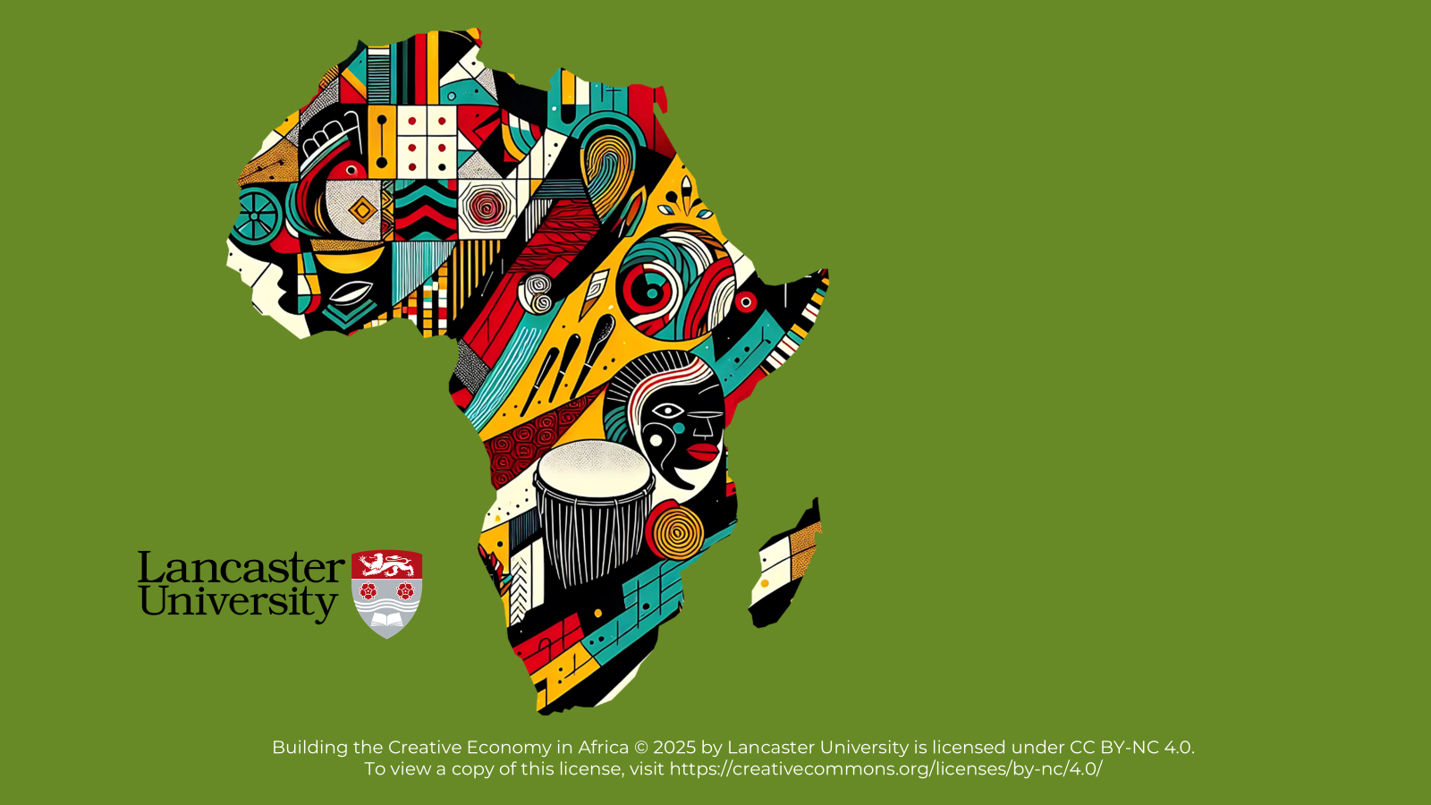

BUILDING THE CREATIVE ECONOMY IN AFRICA

Slide 2
Course Structure
Part One: Creative Economy and Business Development
Unit 2: Developing Creativity into a Business
Unit 3: Discovering Your Market
Unit 4: Building Creative Collaborations and Communities
Part Two: Sustainability and Resilience
Unit 6: Navigating Challenges: How to Build Resilience in the Creative Economy
Unit 1: What Is a Creative Economy and Why Does It Matter?
Unit 5: Understanding Sustainability in the Creative Economy

Slide 3
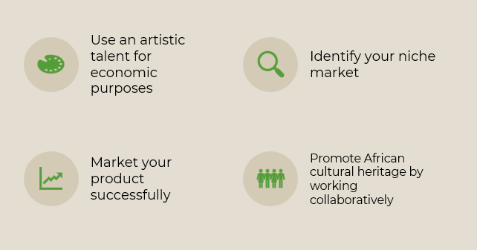
Course Objectives

Slide 4
Ice Breaker Activity

Slide 5

What is the Creative Economy and Why Does it matter?
Unit 1

Slide 6
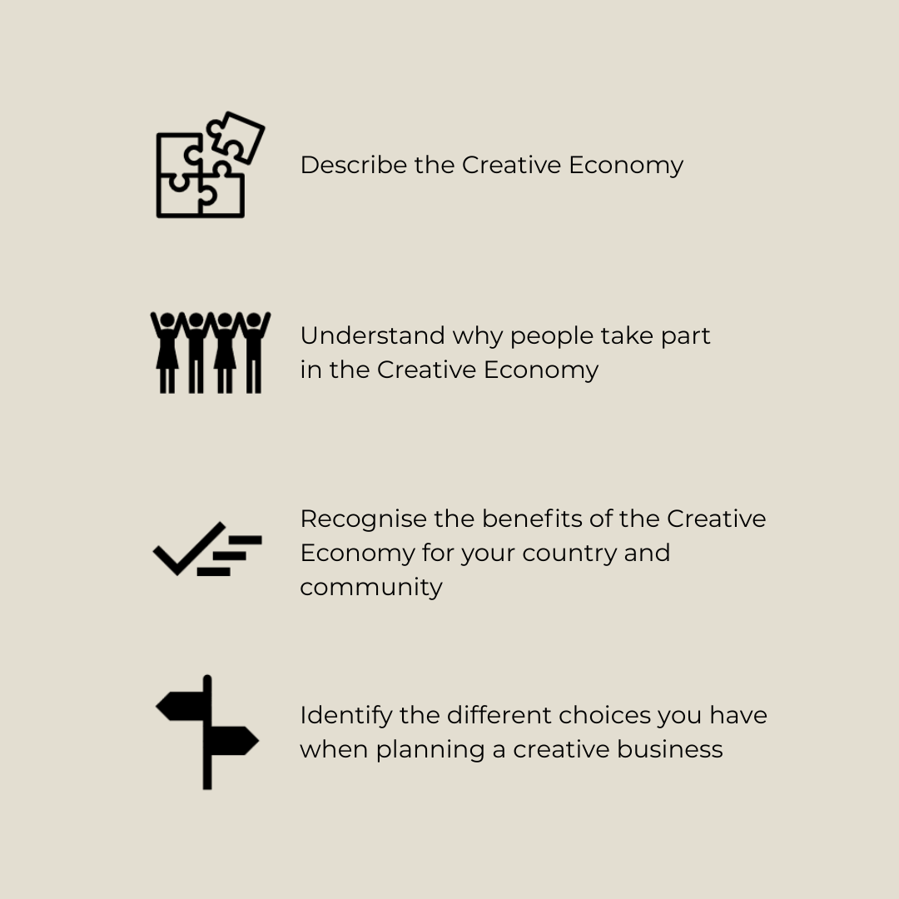
Learning Objectives

Slide 7
Pre-Course Self Evaluation

Slide 8
Think about these three statements and rate them between 1 and 5. With 1 being that you feel that you know very little, and 5 that you have extensive knowledge and expertise in the area. *
1. I understand what the Creative Economy is.
2. I know how to generate an income from a niche market.
3. I know how to use my African culture and heritage within a creative business.
*Complete this exercise on the Microsoft Course Evaluation Form provided.

Slide 9
Creativity is…
Thinking differently – new ideas and fresh ways to solve problems
Not something you are born with – it is developed through practice and new experiences
Collaborative – working with others improves creative thinking
When you run a business using your creativity, you are part of the Creative Economy

Slide 10
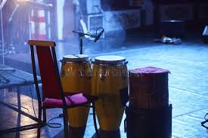

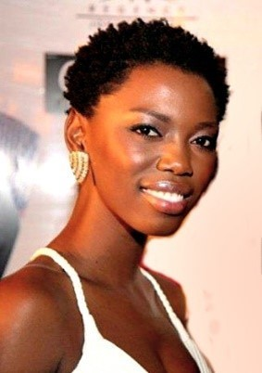
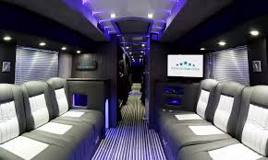
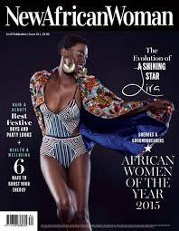

While definitions of the Creative Economy vary, they all highlight the importance of creative skills and the wide variety of jobs and work they support.
Musicians, dancers, sound engineers
Streaming platforms
Tour managers, agents, security
Lira, South African Afro-soul vocalist
Promoters, publicists, photographers, fashion designers
Venue owners and staff

Slide 11
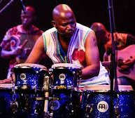
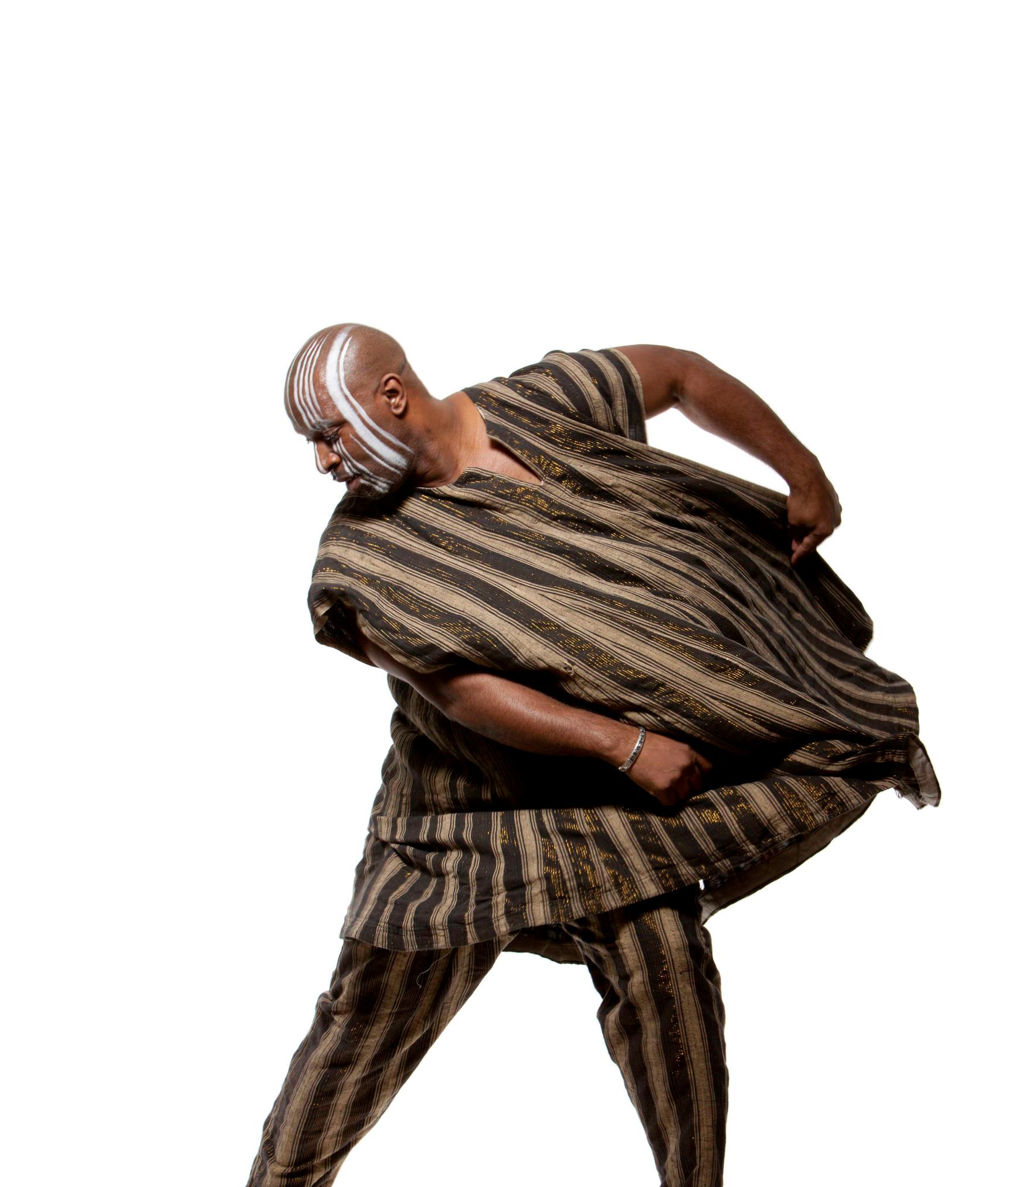
Activity 1: Artist’s Perspectives on the Creative Economy
As you listen to Dr ‘H’ Patten and Volley Nchabaleng, think about these questions:
What struck you most about each artist's stories?
Do you relate to either of the artists? How?
What similarities do you notice between the two artists?
How do their stories connect to broader themes in the Creative Economy?

Slide 12
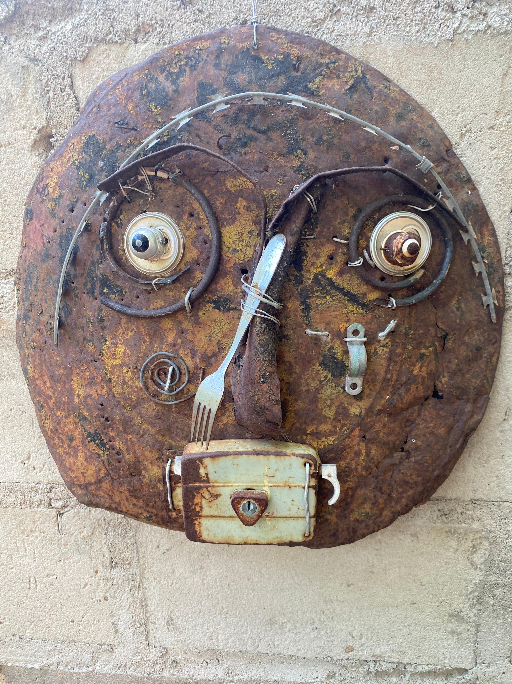
Activity 2: Talking About Your Artistic Identity
What type of art do you create or are inspired to create?
How does your art draw on your cultural heritage?
Why do you want to pursue creative work as a business?
How will you (or do you) earn a living from it?
Artwork by Mozambican sculptor Mulhuvela Mazuze

Slide 13
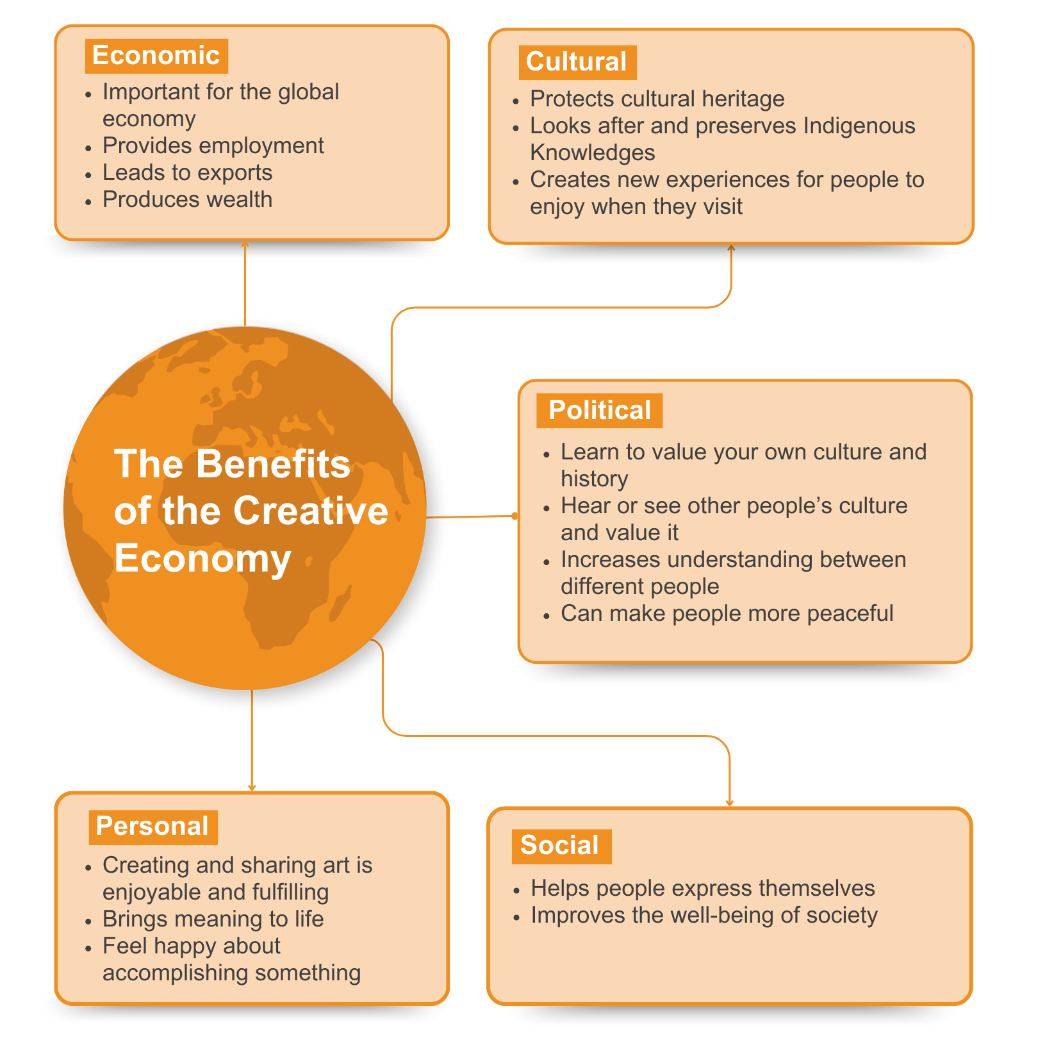

Slide 14

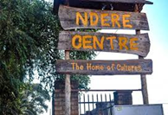
What are the Different Types of Creative Businesses?
Types of Skill
Types of Business
Notes:
Lifted these images from the subsequent activity. Thought you can refer back to explain these so you have images to explain some of the other classifications

Slide 15
Activity 3: Job Creation in Creative Industries
Classification of Creative Industries
1 | Heritage | Cultural sites (archaeological sites, museums, libraries, exhibitions, etc.) Traditional cultural expressions (art, crafts, festivals, celebrations)
2 | Arts | Visual arts (paintings, sculptures, photography, and antiques) Performing arts (live music, theatre, dance, opera, circus, puppetry, etc.)
3 | Media | Publishing and printed media (books, press, and other publications) Audiovisuals (film, television, radio, and other broadcasting)
4 | Functional Creations | Design (interior, graphic, fashion, jewellery, and toys) New media (software, video games, digitised creative content) Creative services (architectural services, advertising, creative R&D, cultural and recreational services).
Notes:
Rather than replicate the list of skills from the Unit that goes before the classification table, thought you could turn it into a quickfire brainstorming activity asking people. Write them on board and then add in any they miss

Slide 16

Types of Business
Type of company | Description | Example
Sole Traders | A sole trader is someone who works alone. They keep all the profits after paying their costs, but they are also responsible for any losses. | A photographer who takes pictures for clients, edits them, and sells prints works as a sole trader. They make money directly from their work but also bear the cost of equipment and editing software.
Partnerships | In a partnership, two or more people work together and share the profits based on an agreement. They combine their skills and money to grow the business. However, they also need to agree on how to divide profits, which can sometimes cause disagreements. | A jewellery-making duo, where one partner designs the jewellery and the other handles the sales and marketing. They split the profits after covering the cost of materials and other expenses.
Companies | A company involves more people and often requires more money to start. The profits might go toward paying back loans, improving the business, or rewarding investors. While companies can make larger profits, these are usually shared among many people. | A fashion brand with a team of designers, marketers, and investors. The company uses profits to expand, pay employees, and sometimes give a return to investors who helped fund the business.
For Profit

Slide 17
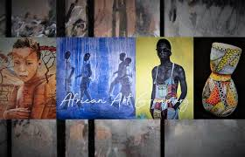
Not for Profit
Types of Business
Type of company | Description | Example
Not for Profit
Social Enterprise | This type of business wants to do good for society while also making money. The business will try to use some of its profits to help the community. | A theatre group that puts on performances to raise awareness about social issues, like climate change or poverty. The money earned from ticket sales might be used to support community projects or teach arts to young people in underprivileged areas.
Co-operatives | In a co-operative, the workers and sometimes the people who use the products share ownership of the business. They work together to make decisions and share the profits. | Several artists share a gallery space. They all contribute to running the business, such as managing the gallery, promoting events, and selling artwork. The profits from the gallery are divided equally among the artists who are involved.
Image: African Art Group
Non-profit initiative dedicated to promoting the talents and artwork of selected African artists through a virtual gallery platform.
https://africanartgroup.org/

Slide 18

Activity 4: Mapping Your Creative Business
Think about your own creative business or the one you want to have:
What are the skills you do or will use?
Which business type fits how you want your business to work?

Slide 19

Activity 5:
A Chocolate Entrepreneur’s Journey
As you read the transcript, make notes on these questions:
What challenges were faced setting up the business and how were they overcome?
What local resources were used?
How did the business become market leading?

Slide 20
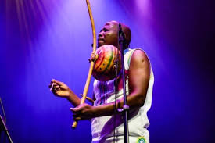
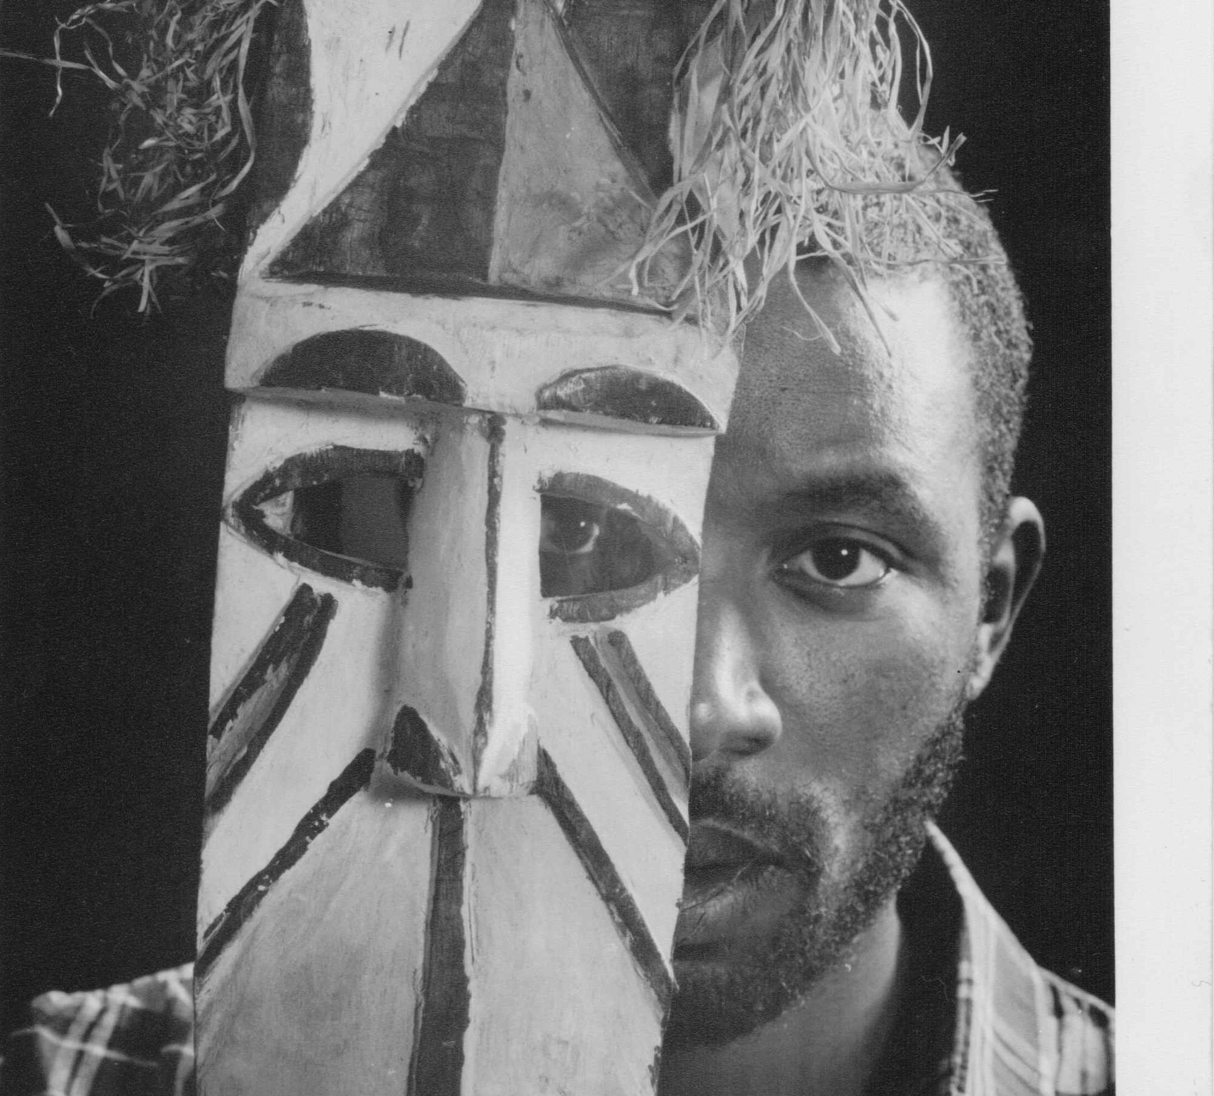
Activity 6: Setting up a Business in the Creative Economy
Remember ‘H’ and Volley? We are going to hear from them again, talking about how they established themselves in the Creative Economy.
As you listen, can you identify:
Any strategies they used to help set up their business?

Slide 21
What Skills Do You Need to Take Part in the Creative Economy?
Creativity
Strong Ethics
For innovative ideas and problem-solving
To ensure integrity and long-term growth
Flexibility
Professionalism
To adapt to changing situations
To maintain credibility and foster trust

Slide 22
Activity 7:
Skills and Qualities for Success
As we hear from ‘H’ and Volley again, make notes on these questions:
The skills both think are important.
The qualities that are needed for a business to work well

Slide 23
Skill | Rationale | Example
Adaptability | The creative industries change quickly. Being flexible helps you adjust to new trends and technologies. | A graphic designer learning new software to keep up with client demands.
Collaboration | Working well with others, even from different fields, leads to better ideas and results. | A filmmaker teaming up with a musician to create a compelling soundtrack.
Critical Thinking | Analysing problems and making smart decisions is key to success. | A marketing team deciding the best strategy to reach their audience.
Communication Skills | Explaining your ideas clearly is important for teamwork and showing clients the value of your work. | A fashion designer presenting their collection to potential buyers.
Digital Literacy | Knowing how to use digital tools is essential as technology shapes industry. | An artist using social media platforms like Instagram to sell their work.
Resilience | Facing setbacks is part of the creative journey, and bouncing back is crucial. | A writer reworking a rejected script until it gets published.

Slide 24
Protecting Your Business
Copyright: Protects creative work like art, music, and writing, giving credit to the creator
Trademark: Protects brands or logos to stop others from copying them
Patent: Protects inventions, like a new tool, such as a paintbrush or a musical instrument

Slide 25
In Conclusion:
What We Have Explored
The importance of the Creative Economy in Africa
The characteristics of the Creative Economy, including its diversity and complexity.
Why creative businesses matter and the ways they can impact society
Skills required to be successful in the Creative Economy
Types of business models that can be applied

