Slide 1


BUILDING THE CREATIVE ECONOMY IN AFRICA

Slide 2

Jointly developed by:

Slide 3

Unit 2:
Developing Creativity into a Business

Slide 4
Ice Breaker Activity

Slide 5
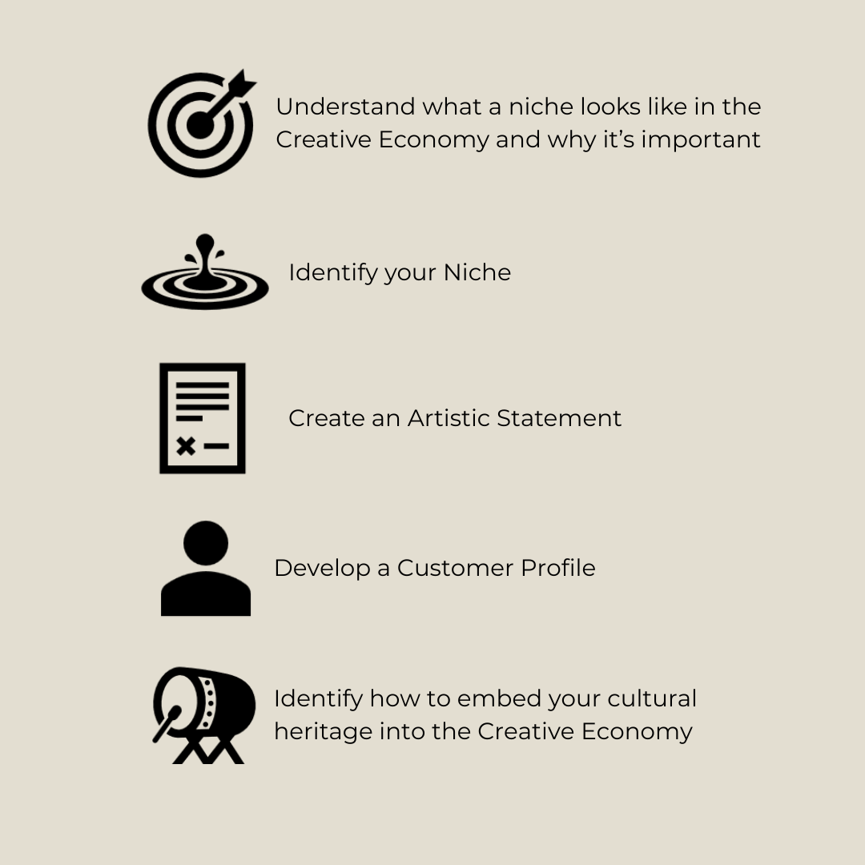
Learning Objectives

Slide 6
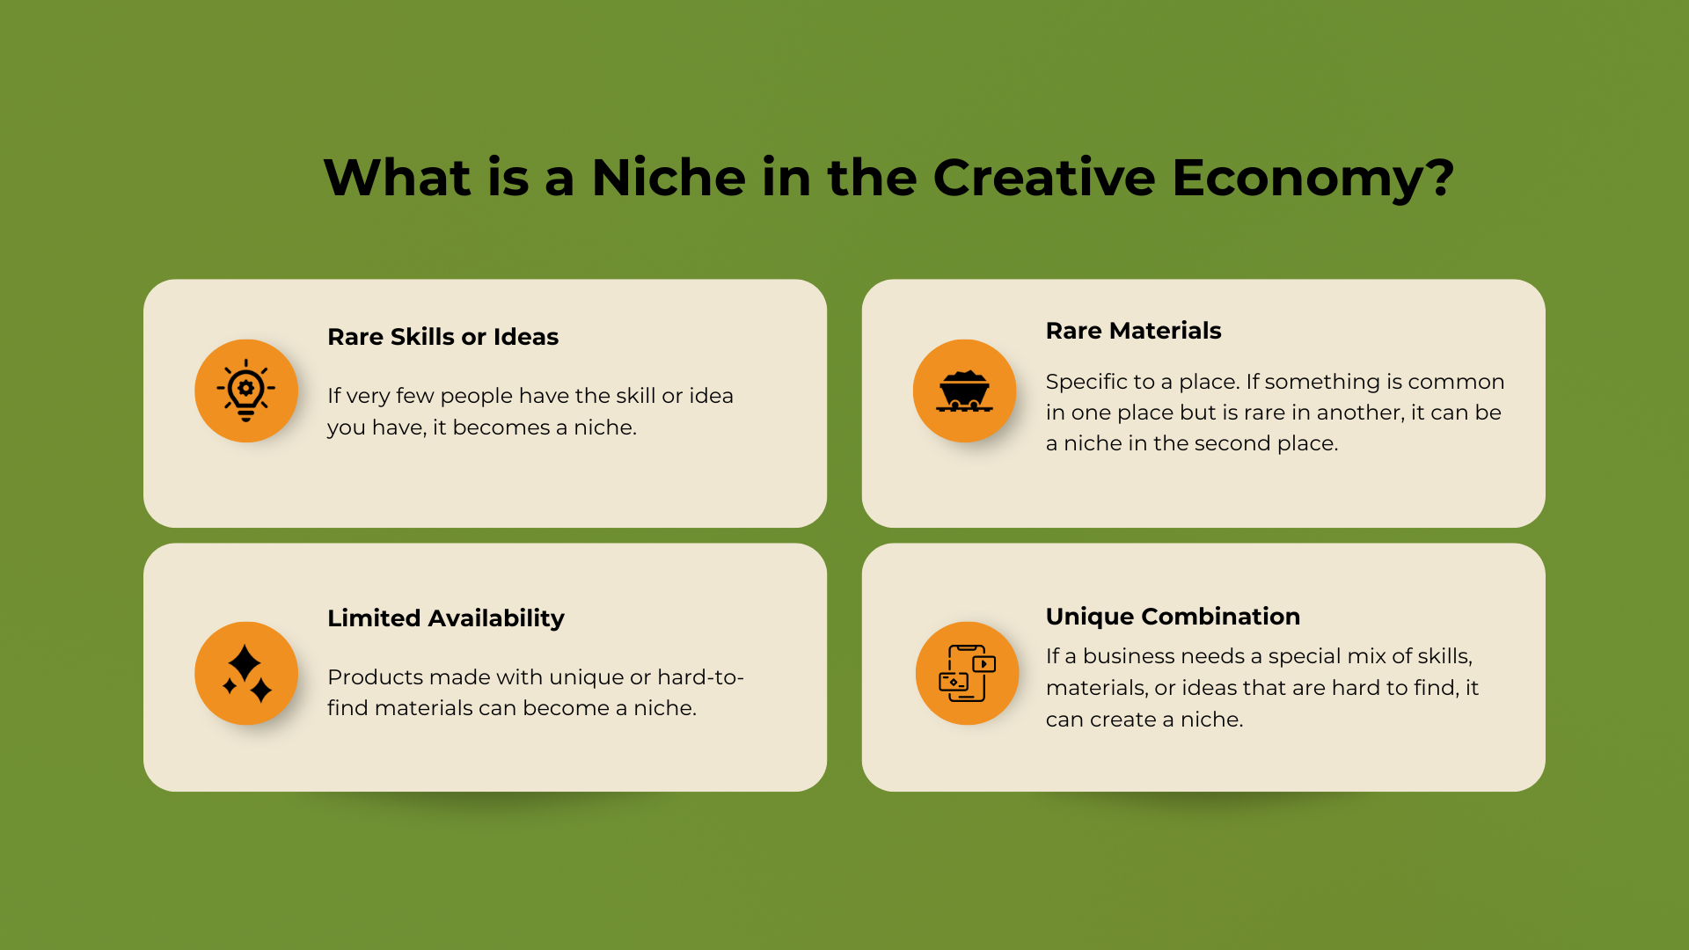

Slide 7


Why Focus your Creativity on a Niche Market?
Reduces competition – the more you go into the specifics of a market the less the competitors
Meets a unique market demand and so it improves sales retention
Builds brand loyalty
Your consumers will be familiar with the product; it reduces the need for general explanations
You can tailor very specific messaging to your audience
It improves reputation and credibility

Slide 8
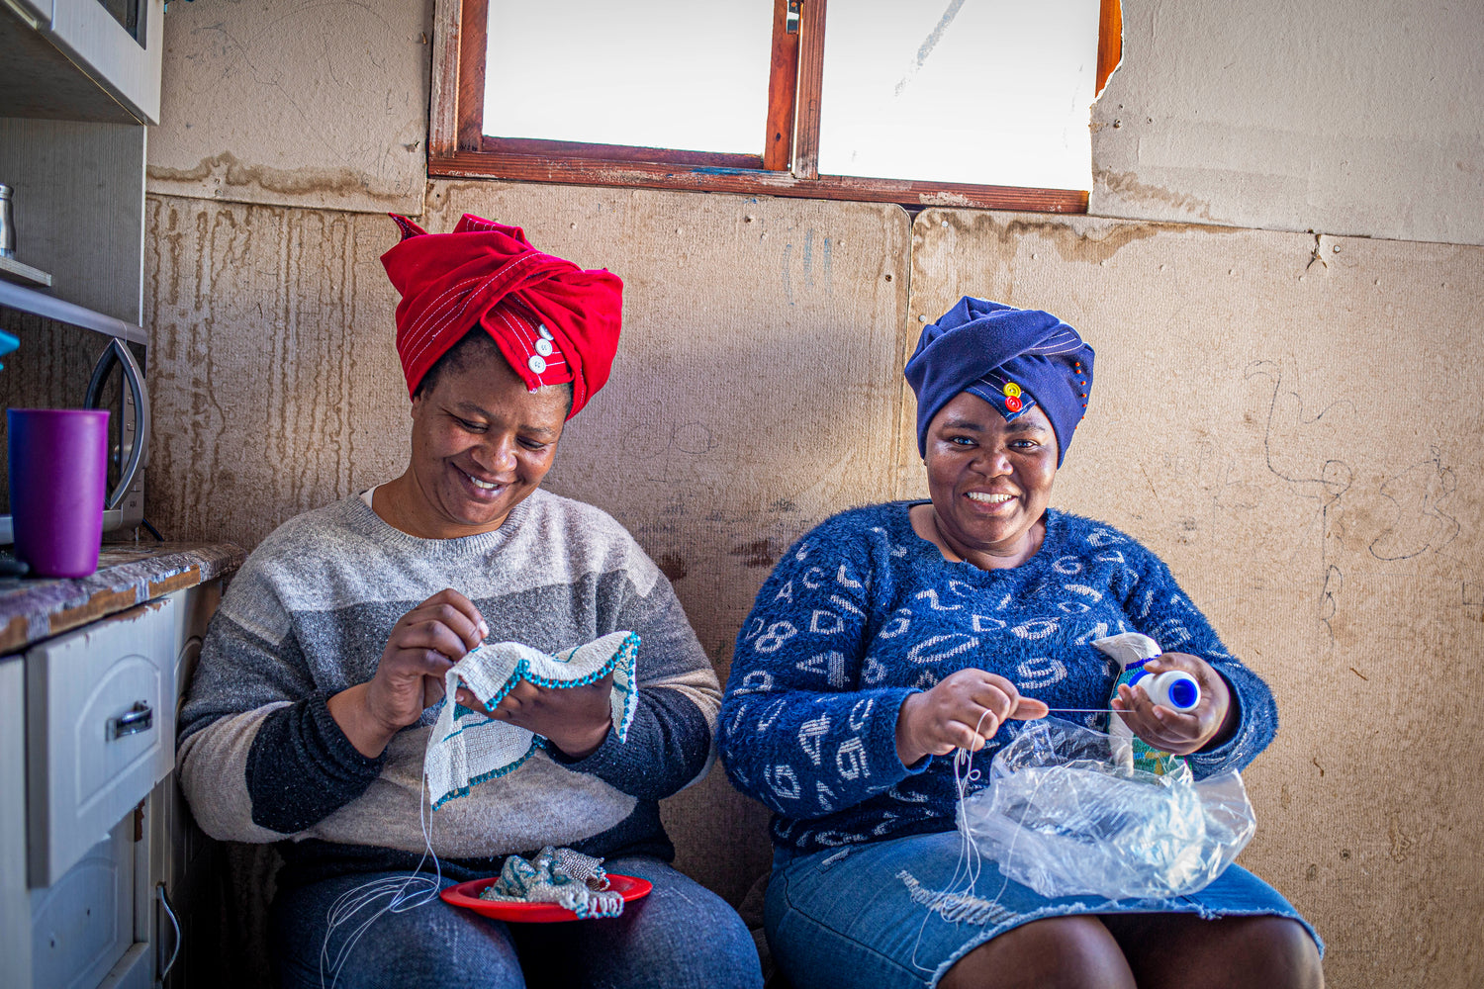
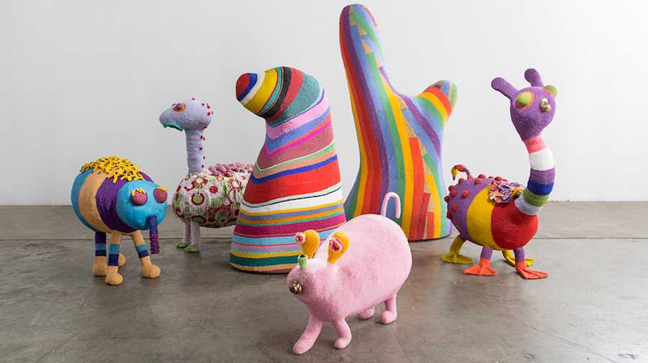
Activity 1:
Turning Cultural Beading into a Successful Business
As you watch the Monkeybiz video, make notes on these questions:
What are the principles guiding their art business?
What is distinctive and niche about the Monkeybiz art products?
Why do they use beads and why do they produce different aims and objects? How did the idea of making bead products come up?
What is their strategy to introduce traditional or unique art forms to a broader or new audience?
How do they differentiate your products in a market possibly dominated by more conventional or commercialised art?
How do they engage with the community, both in terms of artists and consumers?

Slide 9
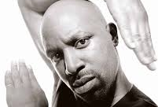

Activity 2: Exploring Two Artistic Niches: Dance and Music
Time to see ‘H’ and Volley again. This time, watch as they tell us about turning their niche skills and talents into a business.
Make notes on the following questions:
What stands out about their passion and niche?
How did the artist’s culture and environment shape their niche?
How do their niches differ from the mainstream art markets they are involved in? What makes them unique?

Slide 10
How Does Their Niche Differ from the Mainstream?
Authenticity: Unlike mainstream storytelling, which often simplifies cultural stories for a wider audience, their work stays true to their African traditions and cultural roots.
Cultural Immersion: While mainstream performances often focus on spectacle or commercial success, their work immerses audiences in African heritage, offering a more authentic and educational experience.
Unique Instruments and Dance:Indigenous African instruments and traditional dances create a distinct sensory experience, contrasting sharply with globally dominant Western styles.
Oral Histories: Rooted in specific times and events, like moonlit nights or ceremonies, they blend storytelling with cultural transmission, unlike mainstream narratives that often lack contextual grounding.

Slide 11
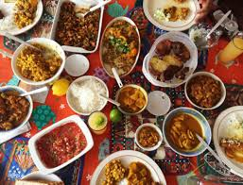
Activity 3: A Culinary Niche in Kenya
We are going to hear another inspiring story.
Meet Aysha, a successful Kenyan cook and entrepreneur. As you watch, think about:
How does Aysha’s approach to her niche compare to the other artists we have heard from?
What strategies does she use to stand out in her field?

Slide 12

Activity 4: Discovering Your Niche
Try to answer the following questions. You could write your responses, draw, use images or photographs, or even video your responses:
What inspires, or is inspiring about you and your art or skill?
Why are you passionate about it and why is it unique?
Why do you think other people might be interested in it and,
Why do you think they may buy your product?

Slide 13
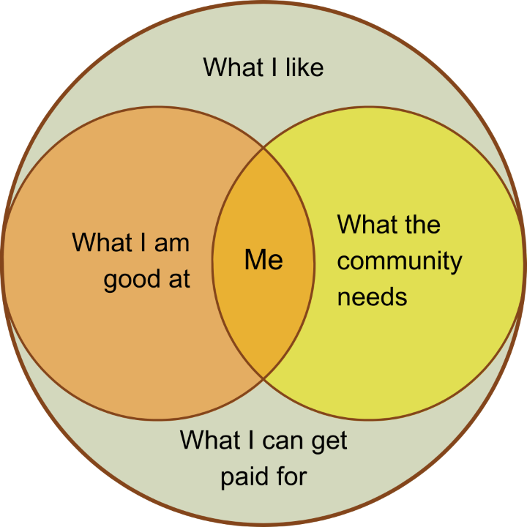
Activity 5: Refining Your Niche
As you start to explore thinking about what makes you and your creativity unique, now you can start to improve and polish your niche identity. Remember, this should be a process you reflect and can refine over time.
Put yourselves in the centre and ask yourself:
What do you like (interests, passions)?
What are you good at (strengths and talents)?
What the community needs (community here is market, so what is the market and what is the need which they respond to)?
What can you get paid for?

Slide 14

Activity 6: Creating an Artistic Statement: Part One and Part Two
An artistic statement helps the audience to understand what you are selling and why you think it is important.
Part One: Once again, we’ll take inspiration from ‘H’ and Volley. As you watch, make notes on these questions:
What stands out most about the artist statements?
What did you like?
Did it give all the information you expected? If not, what was missing?
Part Two: Listen to Lilian and Agnes as they discuss basketweaving.

Slide 15
Activity 7:
Producing Your Artist Statement
An artist statement should be short, about 150 to 200 words. Use simple and clear sentences to explain what your art or cultural skills are and why they are special and unique.
Key questions to guide you:
What is the product?
What motivates you and why did you start the creative process?
What influenced you?
What is unique about the production of this art? This may be the colours, raw materials, the motifs, the technique used to make it, or the style in which it is made?

Slide 16
Activity 7: Producing Your Artist Statement
Key questions cont.
5. What is the gap that you fill in the community and market?
6. Why might people be interested in buying this product?
7. Who is the product aimed at?
8. Why is this product timely?
9. What is the story behind it? What are the indigenous, intergenerational or cultural values in your product and in the ways in which you make this?
10. How will this product improve people’s lives or experiences?

Slide 17
Activity 8: Building a Customer Profile
Characteristic | Types of detail
Demographic | Age | Gender | Ethnicity
Economic Situation | Wealth status or income bracket | Spending behaviour
Personality | Tastes | Trends | Moods
Behaviours | Interests | Hobbies | Likes and dislikes
Where can you find them | Shops in markets | Online | At specialised events like festivals
You will create a 'customer persona'—an imaginary character that represents a key segment of your target audience.
Think about ideal customer and with them in mind try to fill out this table.

Slide 18


Customer Perspective
So far you have thought about it from your perspective. But now we encourage you to look at this from the customer’s viewpoint.
Fill in the following:
In the Rectangles: Reflect on the previous exercise and add the values of your product or service that resonate with this customer.
In the Speech bubbles: Now try to imagine that the customer is saying what they like about your product.

Slide 19
In Conclusion:
What We Have Explored
The importance of refining your niche to ensure it aligns with your interests, strengths, and market demands.
How to create a compelling artist statement that effectively communicates your vision, passion, and unique value.
The concept of customer profiling and its role in understanding audience needs and crafting targeted strategies.
The significance of audience engagement and the different ways products and services can provide value, such as social, experiential, and emotional benefits.

