Slide 1


BUILDING THE CREATIVE ECONOMY IN AFRICA

Slide 2

Unit 3:
Discovering Your Market

Slide 3
Ice Breaker Activity

Slide 4
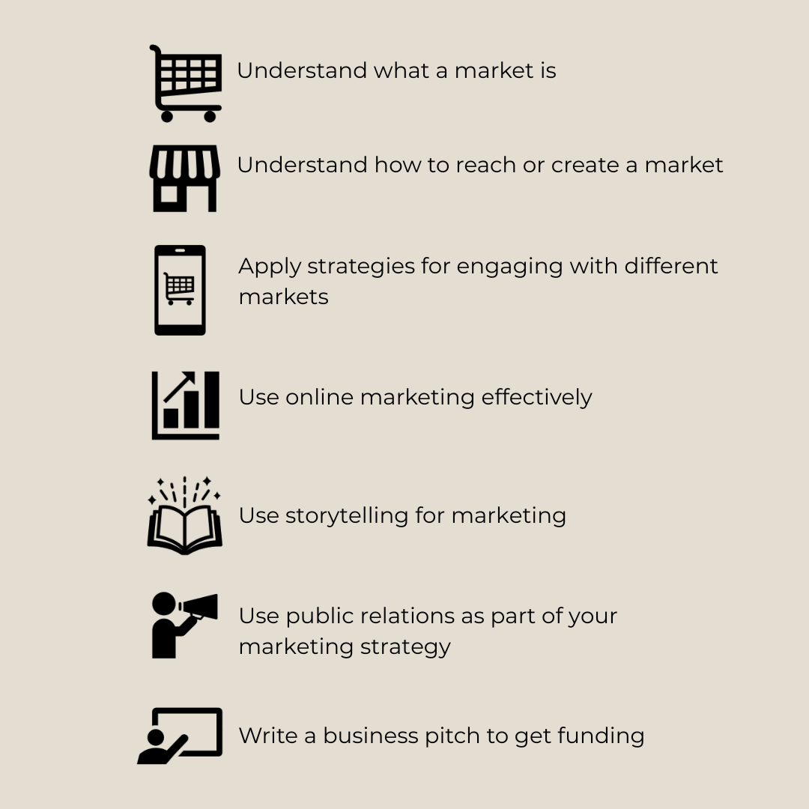
Learning Objectives

Slide 5
Markets
A market is where buyers and sellers exchange goods, services, or ideas
Markets can be physical (e.g., art fairs, galleries) or digital (e.g., social media, online stores).
Key Market Characteristics
Balancing Supply and Demand
Balancing what is created with what
customers want
Competition
Analysing what similar products or services
exist and how to stand out
Customer Preference
Understanding behaviors and trends that
influence purchasing decisions

Slide 6
Activity 1:
Your Market
Try answering these questions:
What do you see as your main market?
How do you market your products or services?
Do you see any gaps in your current marketing strategy?
Where do you market?
Have you ever written a business-pitch before to get funding or to sell your product?

Slide 7
Activity 2:
Finding a Market for Your Business
We are now going to watch two videos of ‘H’ sharing insights about the market. Try to pick up on one point he makes that you think would be helpful for your own marketing strategy.

Slide 8
Know Your Audience
Who you are making for | What they know or want | What you can sell, or how to connect with them
Jamaicans and Africans | They can easily understand the signs and symbols in the work | Cultural products deeply rooted in Neo-African practices
International market beyond this group | They may not be familiar with the cultural language of your art. They don’t know too much about what they want | Cultural products which use universal elements like body language. Adjust your style to ensure that people with different levels of understanding can engage with your work
‘H’s’ point about knowing your audience is crucial because it helps you understand what they might want and how to connect with them effectively.
Although ‘H’ talks about one audience, diversifying your market is essential. Why? Because it:
Allows you to reach new audiences
Increases your visibility
Expands opportunities for your work
Helps you adapt and innovate

Slide 9
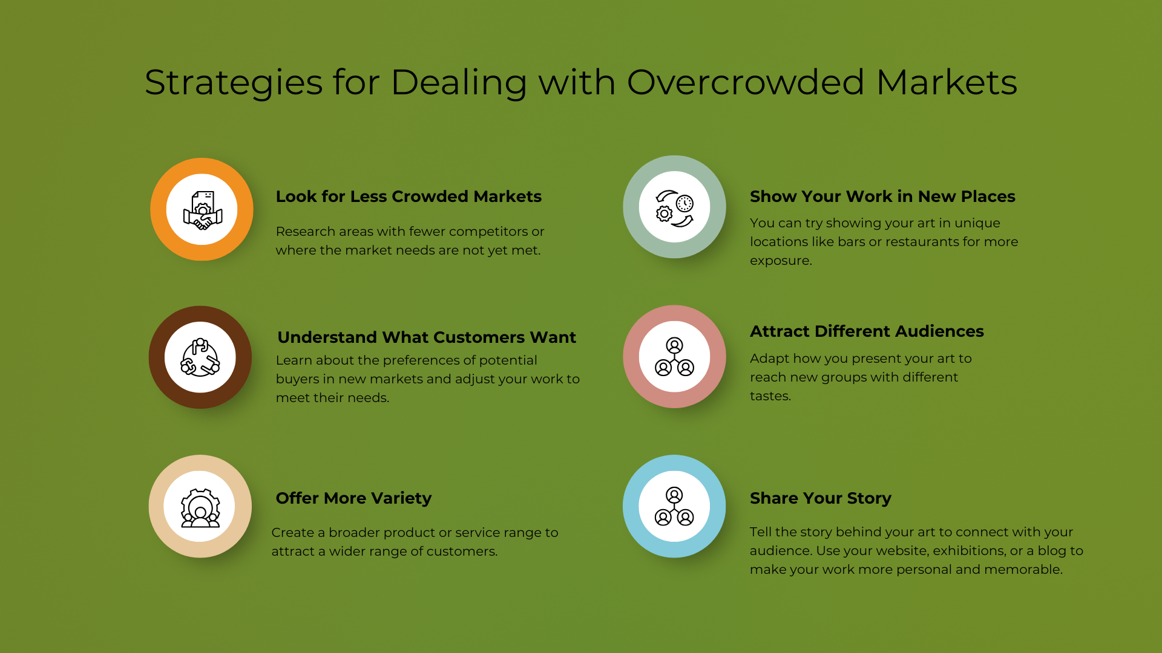
Strateies for Dealing With Overcrowded Markets
Look for Less Crowded Markets: Research areas with fewer competitors or where the needs are not yet met.
Understand What Customers Want: Learn about the preferences of potential buyers in new markets and adjust your work to meet their needs.
Offer More Variety: Create a wider range of products or services to attract different customers.
Show Your Work in New Places: Try displaying your art in unique locations like bars or restaurants for more exposure.
Attract Different Audiences: Adapt how you present your art to reach new groups with different tastes.
Share Your Story: Tell the story behind your art to connect with your audience. Use your website, exhibitions, or a blog to make your work more personal and memorable.

Slide 10





Why Use Online Marketing?
Reach beyond local audiences
Global visibility
24/7 accessibility
How?

Slide 11
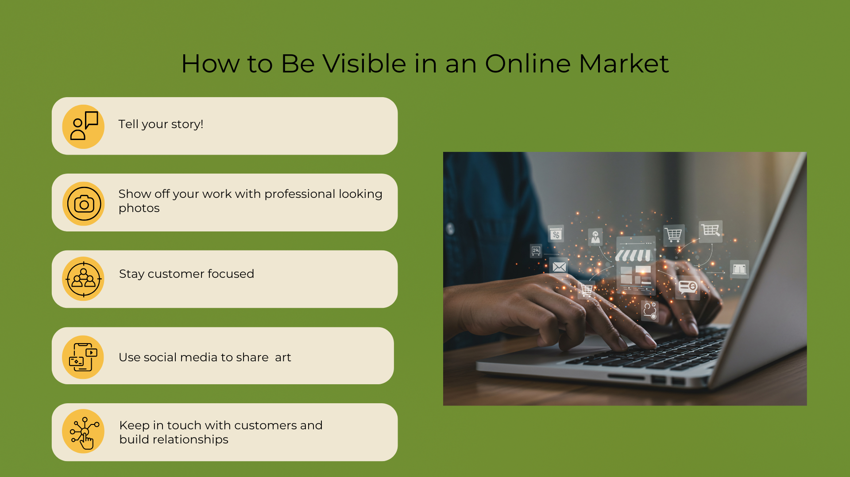
Show off your work with great photos
Tell your story
Customer focus
Use social media to share art
Keep in touch and build relationships

Slide 12
Activity 3:
Do You Have a
Story to Tell?
Storytelling connects emotionally with audiences, making your brand relatable and memorable.
It is likely that there is already a story sitting behind your business, whether you use it actively in your marketing or not.
Is there a story behind your brand?
If so, is it a personal story, about your community and culture, or more about your art form or product?
Why is this story so important to your business?

Slide 13

Activity 4:
Creating Your Brand Story
Step 1:
Reflect on Your Story
Write down your story in a way that feels natural to you. Focus on capturing the core elements, emotions, and any key moments. Some guiding questions that can help you with this are:
What is your story about? Write one sentence to explain it.
How did you feel during the experience?
What were the most important moments in your story?
What details or people should you include to make the story clear?
What message do you want others to take from your story?

Slide 14
Step 2:
Write Your Story
Write down your story in a way that feels natural to you. Focus on capturing the core elements, emotions, and any key moments. Some guiding questions that can help you with this are:
What is your story about? Write one sentence to explain it.
How did you feel during the experience?
What were the most important moments in your story?
What details or people should you include to make the story clear?
What message do you want others to take from your story?
Step 3:
Analyse Your Story
Use the following questions to guide your analysis:
First Round: Understanding Your Story
Core Theme: What is the central theme of your story? Summarize it in a sentence.
Emotional Impact: How does the story make you feel? What emotions are tied to it?
Clarity: Are there any parts of your story that might seem unclear to someone else? What details could you add to make it more engaging?
Second Round: Digging Deeper
Key Moment: What is the most important or turning point in your story? Why is it significant?
Message: What is the main message or lesson of your story? How might it connect with others?
Step 4:
Reflect and Apply
Reflect on what you have learned about your story.
How could storytelling enhance your creative process or help you connect with your audience?
Use the insights from this activity to inspire or shape a new piece of art.

Slide 15
Effective Brand Storytelling Do’s and Don’ts
Do
Express Your Brand's Values | Clearly communicate the principles and values that define your brand
Incorporate Diverse Content | Use a mix of high-quality content, real-life stories, and testimonials from customers and employees to make your narrative relatable
Use Engaging Facts and Evidence | Share accurate, verifiable information in an engaging way to strengthen your brand’s story
Establish Emotional Connections | Build trust and authenticity by highlighting the human side of your brand
Don’t
Dishonesty for Profit | Avoid misleading or false claims just to make money
Manipulative Tactics | Don’t exploit emotions to take advantage of your audience.
Overstating Capabilities | Be honest about what your brand can do—don’t exaggerate.
Unsubstantiated Boasting | Back up claims about your brand’s excellence with evidence.

Slide 16
Activity 5:
Exploring Kente
As you watch the Kente cloth video, reflect on these points:
How can cultural heritage be used to build a strong brand identity?
What role does storytelling play in branding African products?
How does African storytelling enhance brand narratives?
Why is legacy and tradition important to African product branding?

Slide 17
Public Relations in a Creative Economy Business
Public relations means managing your public image and relationships with media and communities
Top Tips:
Start locally
Reach beyond your area
Teach and share your knowledge
Open your studio to visitors
Attend art fairs and exhibitions
Engage with your community
Create videos
Network with other artists
Sell at markets and fairs

Slide 18
Activity 6:
Insights from a Project Manager
Watch the video and then explore different strategies Puleng uses.
Using Social Media for Creative Businesses
Include social media in your promotion plans
Consistency matters!
Find useful contacts
Working With Traditional Media
Use TV and Radio
Be persistent
Find contacts
Puleng’s Day-To-Day Tasks
Writing proposals
Sending proposals
Managing invoices
Communicating

Slide 19

The Structure of a Creative Business Pitch
Structure of a Business Pitch
Hook
Start with a compelling fact, question, or story
Problem Statement
Real-world problem the idea will solve
Solution
Explain the unique, creative solution your business offers
Value Proposition
Show the solution as valuable, feasible, and scalable
Target Audience Describe the customer base and their needs
PR Campaigning Plans for advertising your brand to you core customer base
Market Opportunity and Strategy
Market size, competition, and why your business will succeed
Revenue Model Explain how the business will make money
Call to Action End with a clear ask (investment, partnership, or support).
Notes:
Get rid of the image if you don’t like – elevator pitch metaphor

Slide 20
Tips For Delivering
Your Pitch
Practice: Rehearse to ensure smooth delivery.
Clarity: Use simple, impactful language.
Visuals: Use slides, videos, prototypes, or visuals to enhance understanding.
Confidence: Maintain eye contact, a strong voice, and positive body language.
Time Management: Stick to the allotted time (e.g., 3-5 minutes).

Slide 21
In Conclusion:
What We Have Explored
The structure of a creative business pitch and its key components.
The importance of a clear and engaging presentation to convey your vision and value.
Practical tips for delivering an impactful pitch, including confidence, clarity, and the use of visuals.
An example of a well-crafted pitch, illustrating how creativity can connect cultural heritage with contemporary markets.

