Slide 1
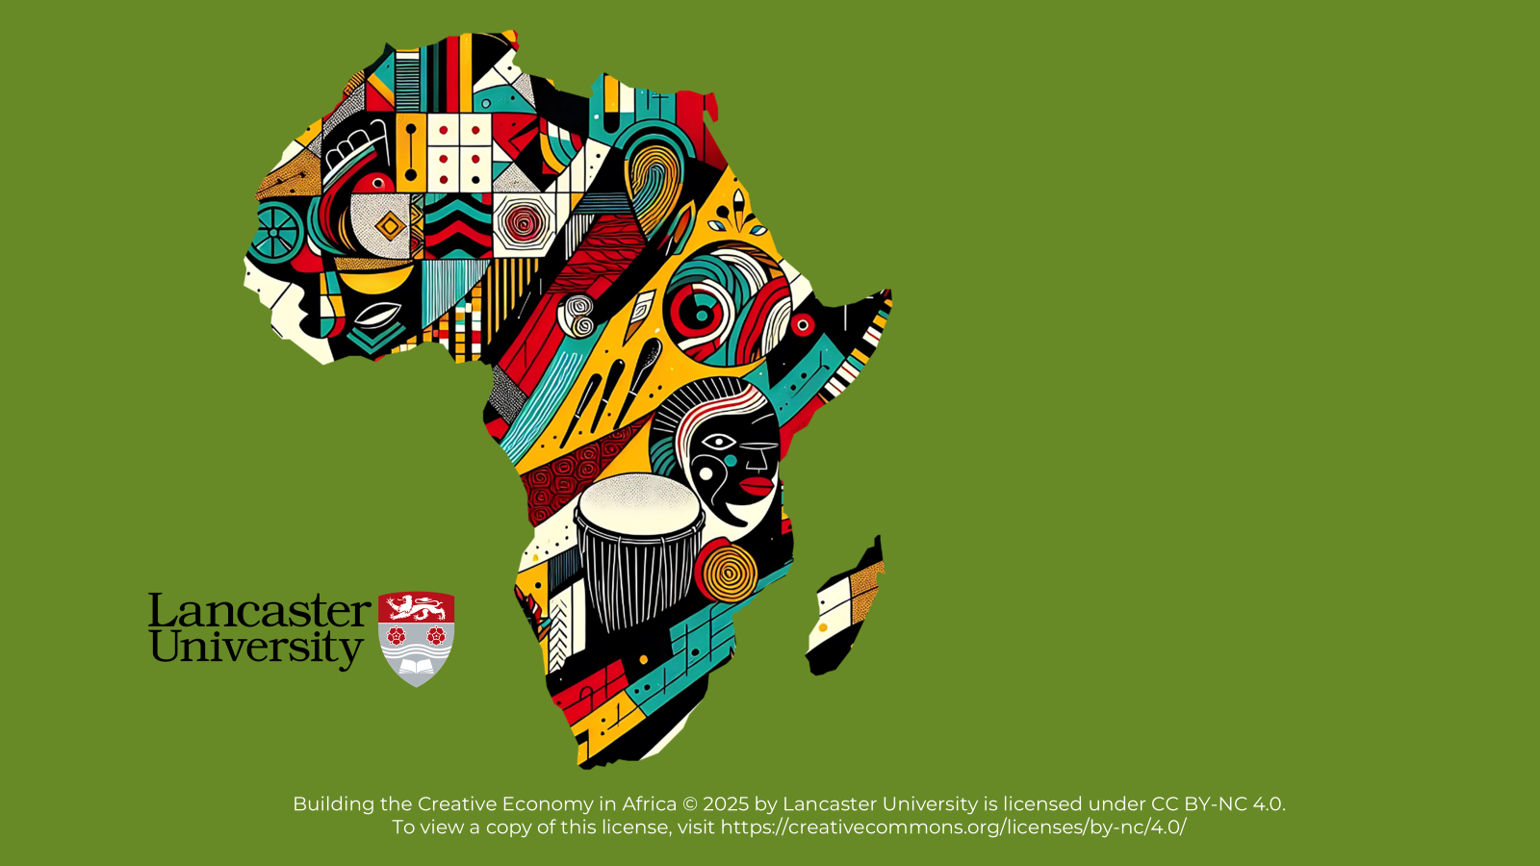

BUILDING THE CREATIVE ECONOMY IN AFRICA

Slide 2
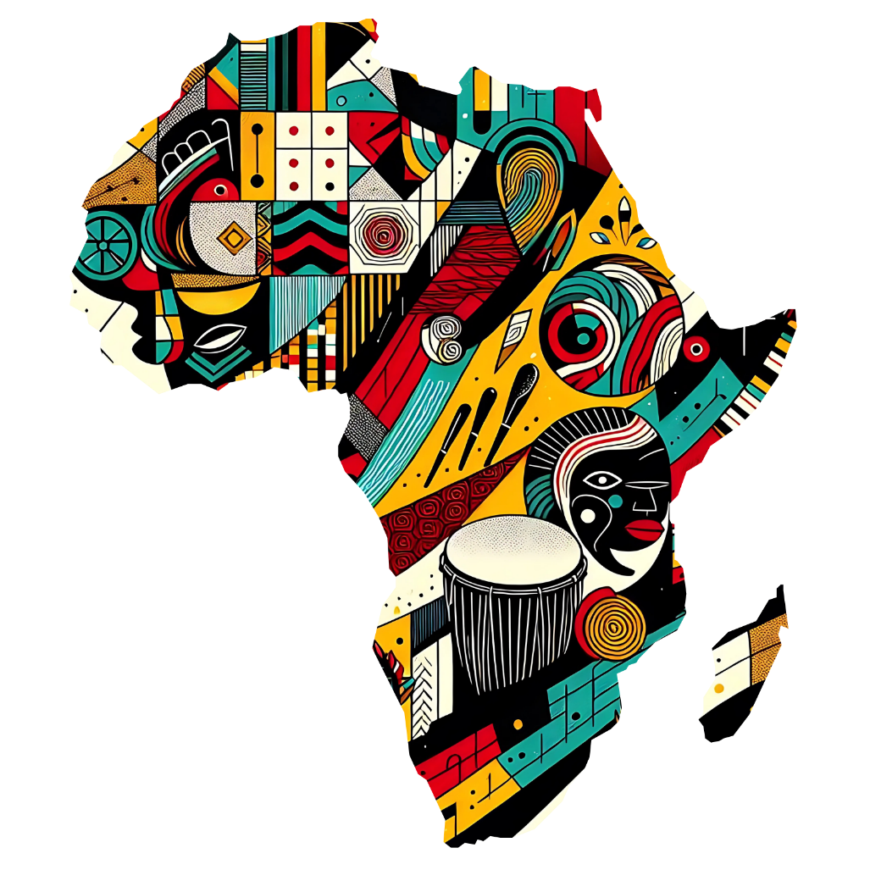
Unit 4:
Building Creative Collaborations and Communities

Slide 3
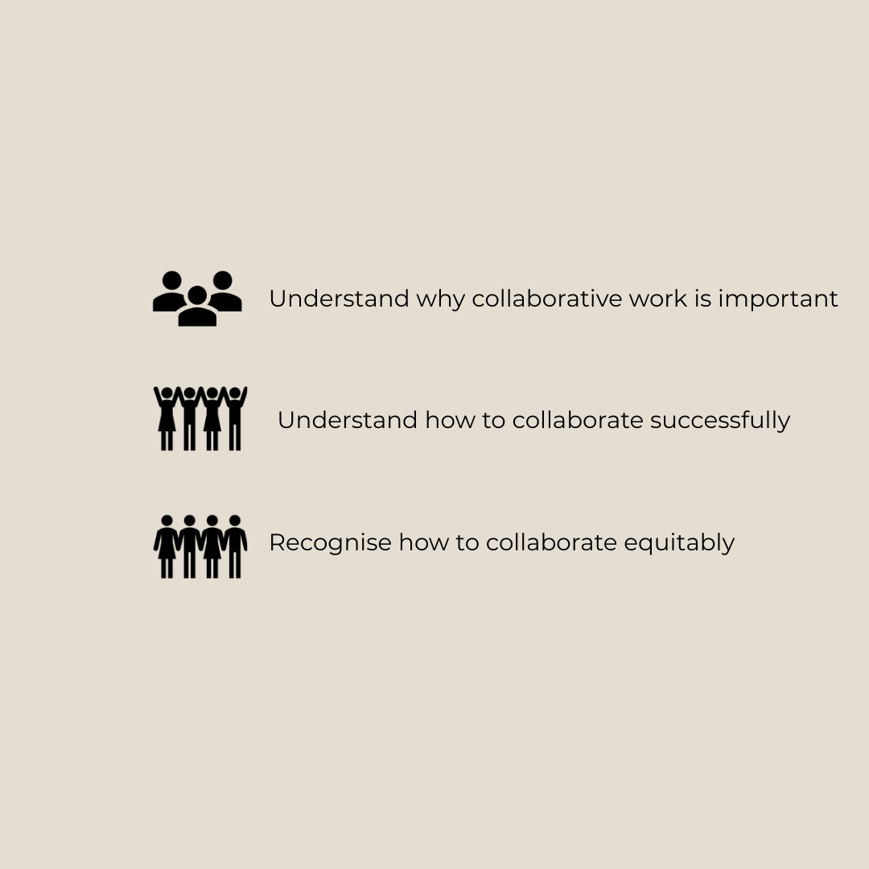
Learning
Objectives

Slide 4
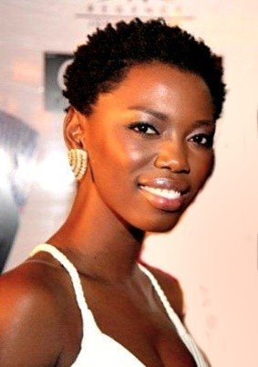
Refresher Activity
Think back to the South African Afro-soul artist Lira exercise we did in Unit 1
All of the different people and professions surrounding her to be able to perform and have her career. How are these connections?

Slide 5
Reasons To Collaborate
“If you want to go fast, go alone, if you want to go far, go together”
African Proverb
Collaborating means working together towards a common goal. In this case, it is to create a creative product. Collaborations can:
Act as a creative resource
Become a learning resource
Improve community relations
Be fun!

Slide 6

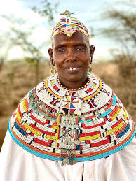
Activity 1: Community Based Arts Project
Having explored the BeadWORKS Africa website, we concluded they are successful because they:
Use Indigenous Knowledge
Work collaboratively
Connect storytelling to their identity
Build capacity through partnerships

Slide 7
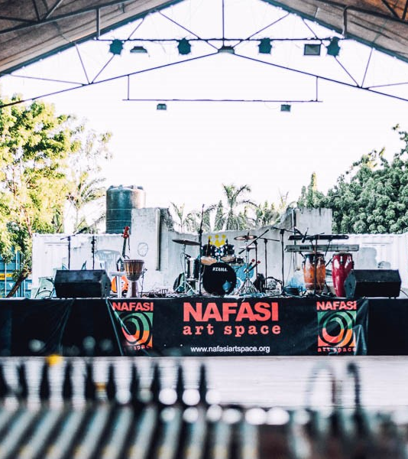
Activity 2: Understanding the Value of Communal Arts and Cultural Initiatives
As you watch the video about the Nafasi Art Space, think about these questions:
What is it that is driving these creatives to come together?
Why do they need this kind of space and what values underpin it?
What forms of collaboration are being created?
What are the benefits of these collaborations?

Slide 8
How To Build A Collaborative Process
Some art forms are naturally shared, while others are created when artists work together and combine their ideas. This section focuses on how collaboration works in the artistic process
Step 1: Before Collaborations Begin
Establishing good communication
Conduct pre-meetings
Flexibility and shared understanding
Embracing diversity
Prepping for the Start
Recognising Inequalities

Slide 9
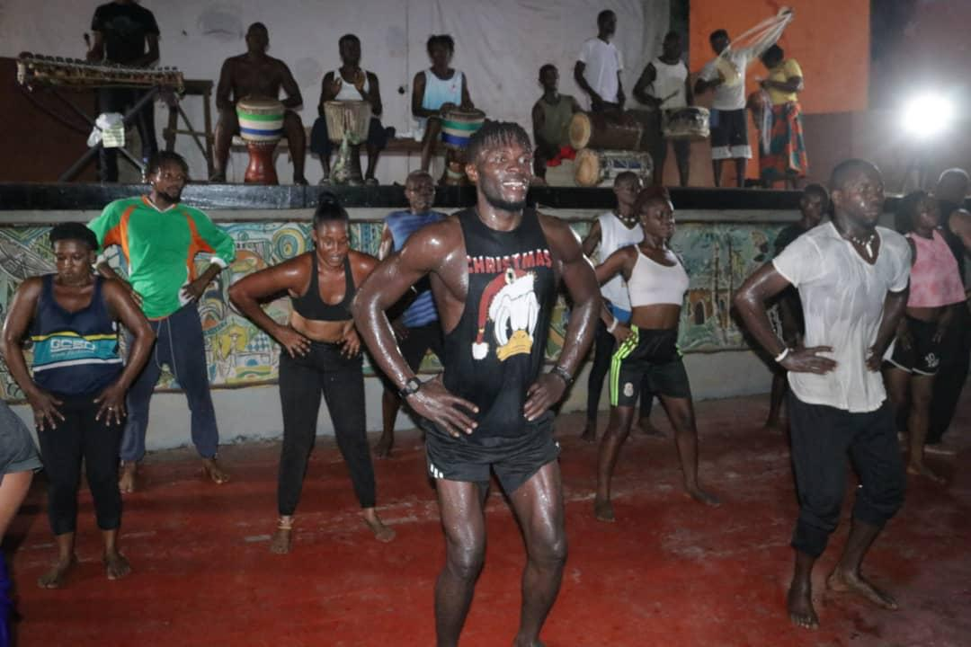
Activity 3: Working with Artistic Differences
As you listen to ‘H’s story, make notes on the ways in which he:
Navigated differences
Fostered mutual respect
Created a harmonious and productive collaborative environment
What are the key principles we can draw on from H’s collaboration with other artists?
Image is from a rehearsal for a Dance for Camera choreographed piece ‘H’ collaborated with the Sierra Leone National Dance Troupe to create

Slide 10
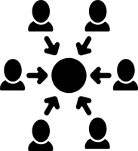



‘H’s Key Principles of Collaboration
Diversity in creativity
Finding common ground for collaborative success
Foster an atmosphere of mutual respect
Trust in the expertise of each collaborator
Experimentation and creative risk taking

Slide 11
Step 2: Creating a Collaborative Space
For any collaboration to begin, people need a space where they can meet and work.
Physical Space
Local Communities
Online Space
Creative Spaces
Classrooms, community halls, parks, outdoor areas and digital platforms

Slide 12
Exploring New Spaces For Creativity
Stepping Out of Your Comfort Zone: Being in a new or unfamiliar space can inspire creative thinking.
How the Setting Affects Group Roles: Changing the environment can shift how people interact and work together.
Changing Up Familiar Spaces: Small changes, like rearranging a room or adding new elements, can make a familiar space feel fresh and encourage creativity.
Balancing Comfort and Novelty: It is important to balance familiarity with the excitement of a new environment.

Slide 13
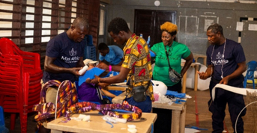
Activity 4: Engaging with the Community in Collaborative Spaces
Here’s what we thought:
Active Involvement: Develop strategies that can actively involve your audience or community in the collaborative process
Encouraging Participant Collaboration: Discover how to facilitate and encourage collaboration among your participants.
Listening and Adapting: Understand the importance of listening to your community and adapting your strategies to meet their needs and leverage their unique contributions.
Image of participants in a creative workshop led by ‘H’ making carnival costumes as part of the 10th International Conference of Carnival & Masquerade Arts hosted by University of Winneba, Ghana

Slide 14
Step 3: Equitable Collaboration
Steps to create fair collaborations
Clear financial plans
Set clear expectations
Be ready to adapt
Build mutual respect
Recognise everyone’s contribution
The final stage offers exciting chances to boost creativity and innovation. However, it is important to make sure everyone gets a fair and equitable share of the rewards. 5 key topics to consider:

Slide 15

Activity 5: Making Creative Collaboration Fair and Beneficial for All
As you listen to ‘H’, make notes on the different ways and techniques that he uses to bring more fair, open and honest relationships with those he collaborates with.
Here is what we thought:
Listening To Others
Not just hearing their words but understanding their needs, ideas and perspectives
Mutual Relationships
Two-way street, where everyone is equal
In many African cultures, the conch shell represents listening and good communication.

Slide 16
In Conclusion: What We Have Explored
The importance of collaborating with others
Steps to collaborate well with others.
How to collaborate equitably.

