Slide 1
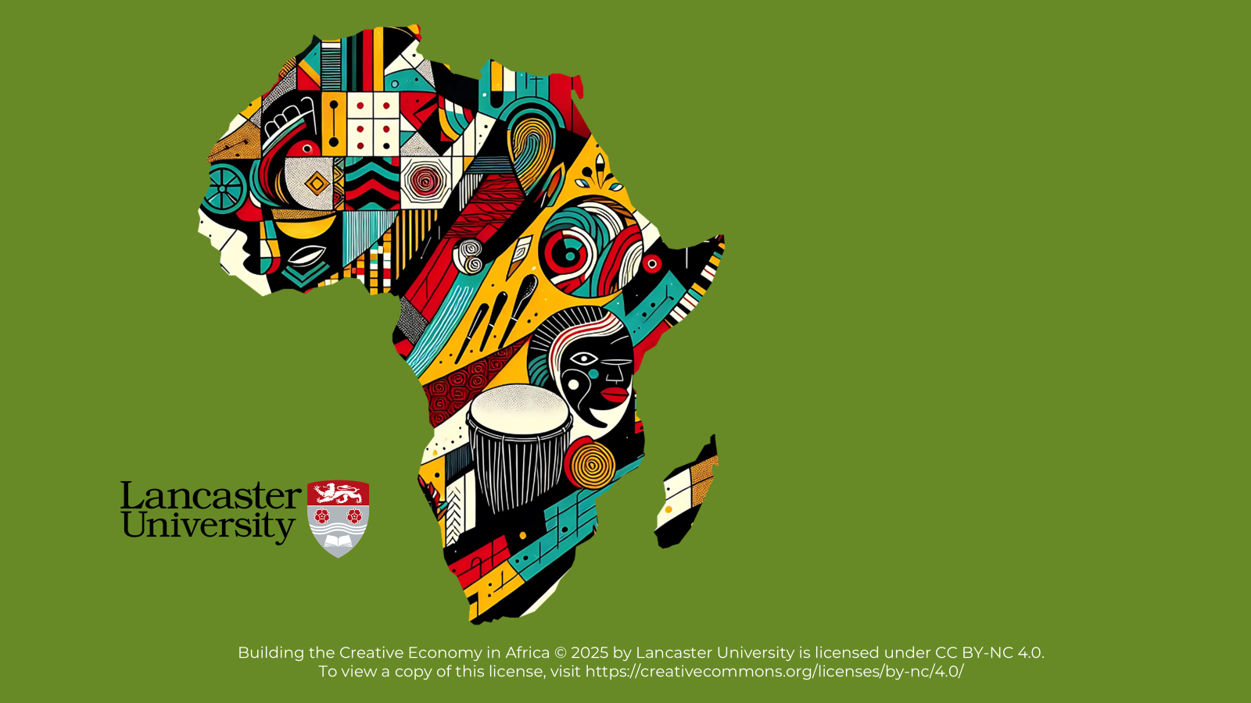

BUILDING THE CREATIVE ECONOMY IN AFRICA

Slide 2
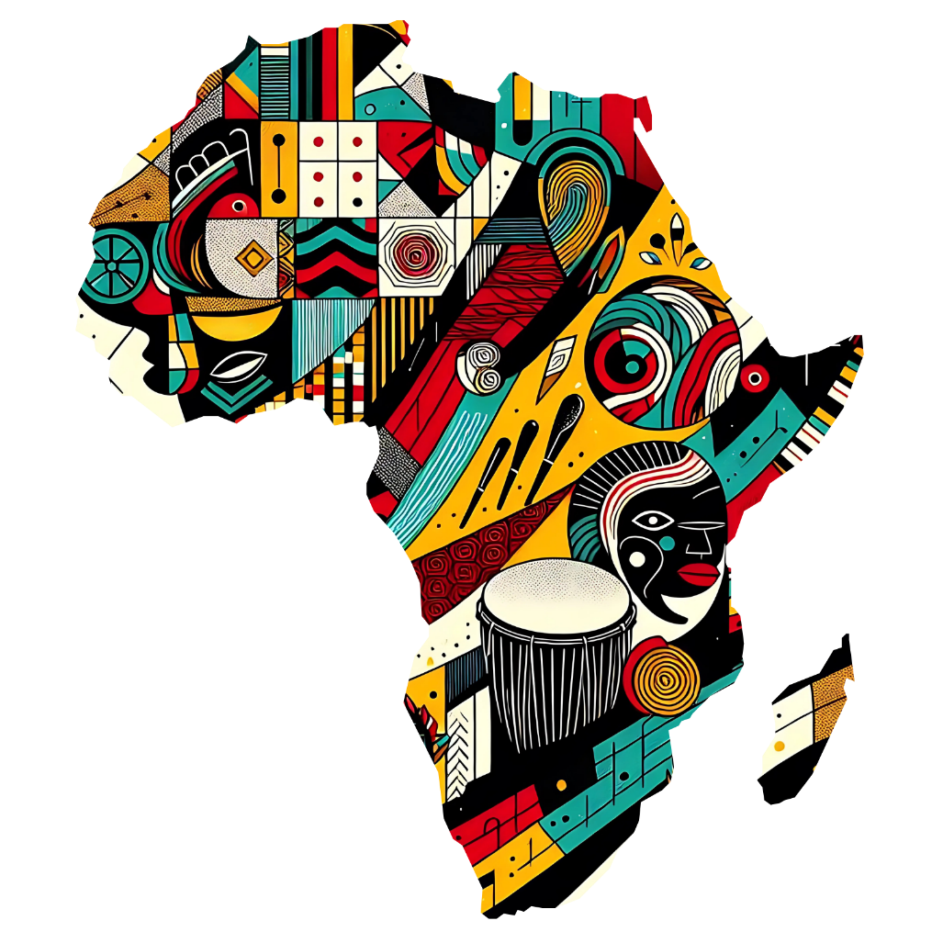
Unit 5
Understanding Sustainability in the Creative Economy

Slide 3
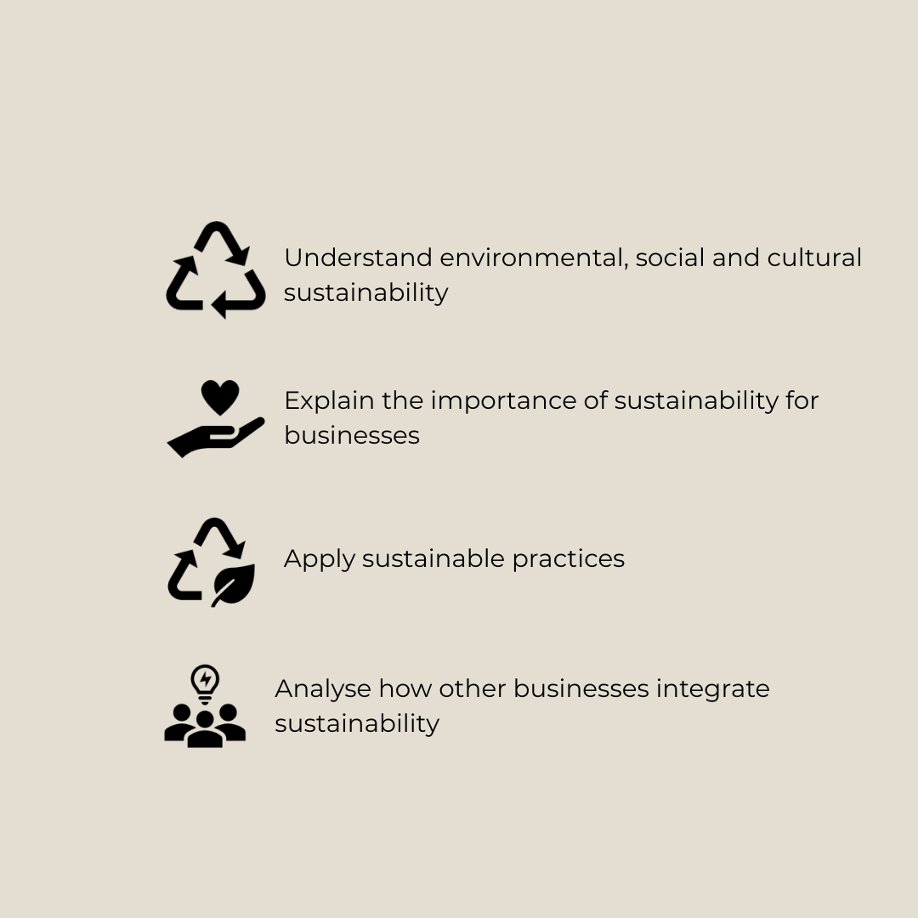
Learning Objectives

Slide 4
Ice Breaker Activity

Slide 5
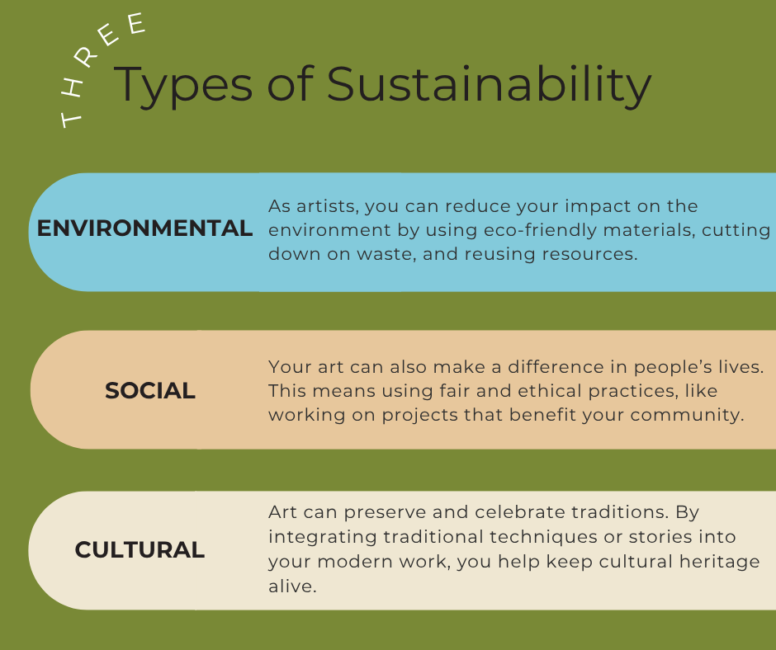

Slide 6
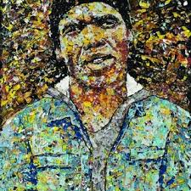
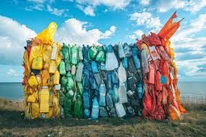
Environmental Sustainability
What is environmental sustainability in the Creative Economy?
Reducing the harm creative activities can cause to the environment
Using natural resources responsibly.
Minimise environmental impact while improving environmental, social and cultural well-being.
Why is environmental sustainability important to the Creative Economy?
Creatives often use materials, energy, and create waste, which can harm the environment.
Help ensure natural resources last longer and show social responsibility.
Eco-friendly approaches can attract customers and partners who care about the environment.
Image: South African artist Mbongeni Buthelezi recycles plastics into portraits
Image: Non-recyclable waste salvaged from the oceans creating coastal artworks

Slide 7
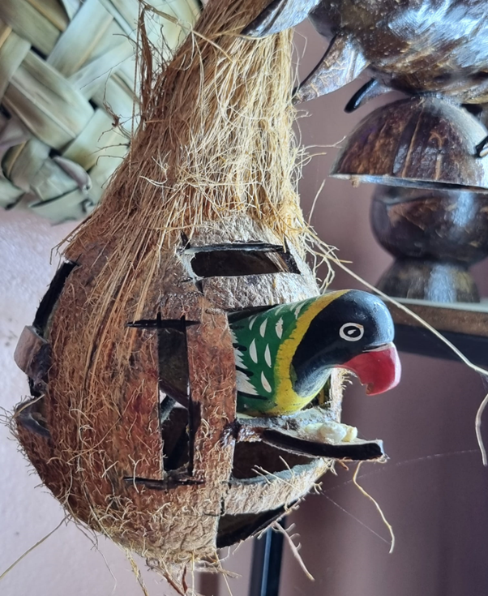
Methods of Environmental Sustainability
Use Eco-friendly Materials
Use organic materials
Use renewable energy from solar panels and
Use energy efficient equipment to reduce your carbon footprint

Slide 8
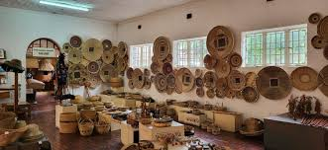
Activity 1: Sustainability Practices at Choma Museum
As you watch the different ways the museum practices material sustainability, think about this question:
Why is it important to prioritise local and natural materials over synthetic ones in crafting?

Slide 9
Methods of Environmental Sustainability – Continued
2. Minimising Waste
Reduce the materials which are thrown away
Design for longevity
3. Repurposing Materials
Important for reducing the environmental impact of creative industries.
Recover materials from old products
Use to create attractive products that can sell in the market
Design sculptures from recycled or biodegradable materials.

Slide 10
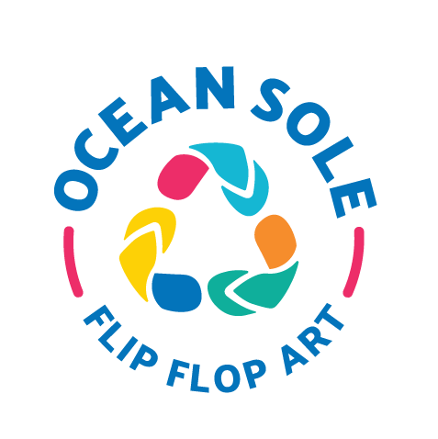
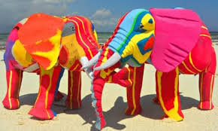
Activity 2:
From Trash to Treasure
Watch the video about the company Ocean Sole. This organisation collects old flip-flops from beaches and turns them into colourful animal sculptures.
As you watch, think about the following questions:
How does Ocean Sole help reduce marine pollution?
Why is repurposing old materials like flip-flops important for sustainability?
What other waste materials could be repurposed like this?
How does Ocean Sole create jobs for local communities?
Why is creativity important to Ocean Sole's success?

Slide 11
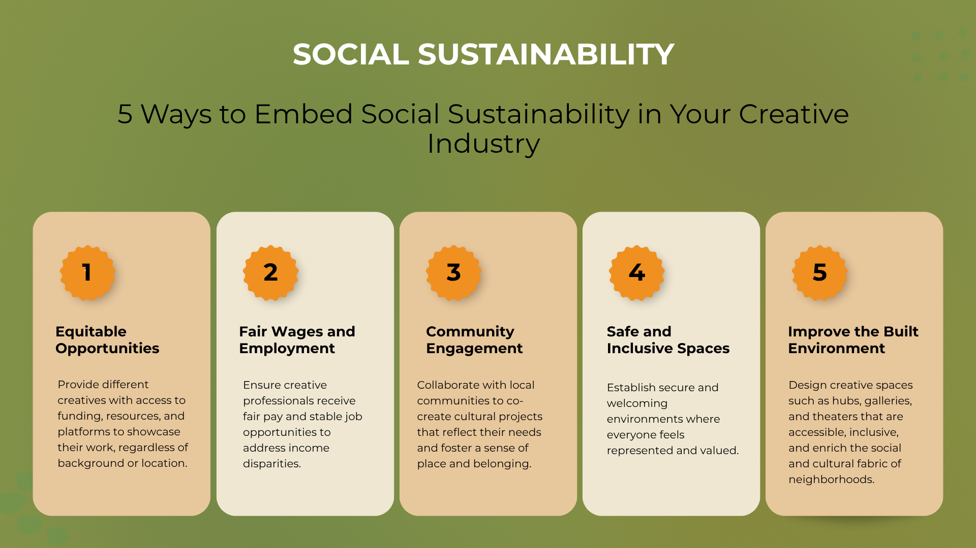
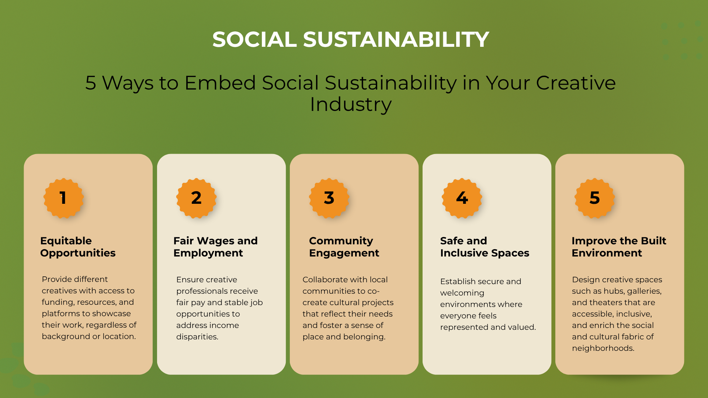

Slide 12
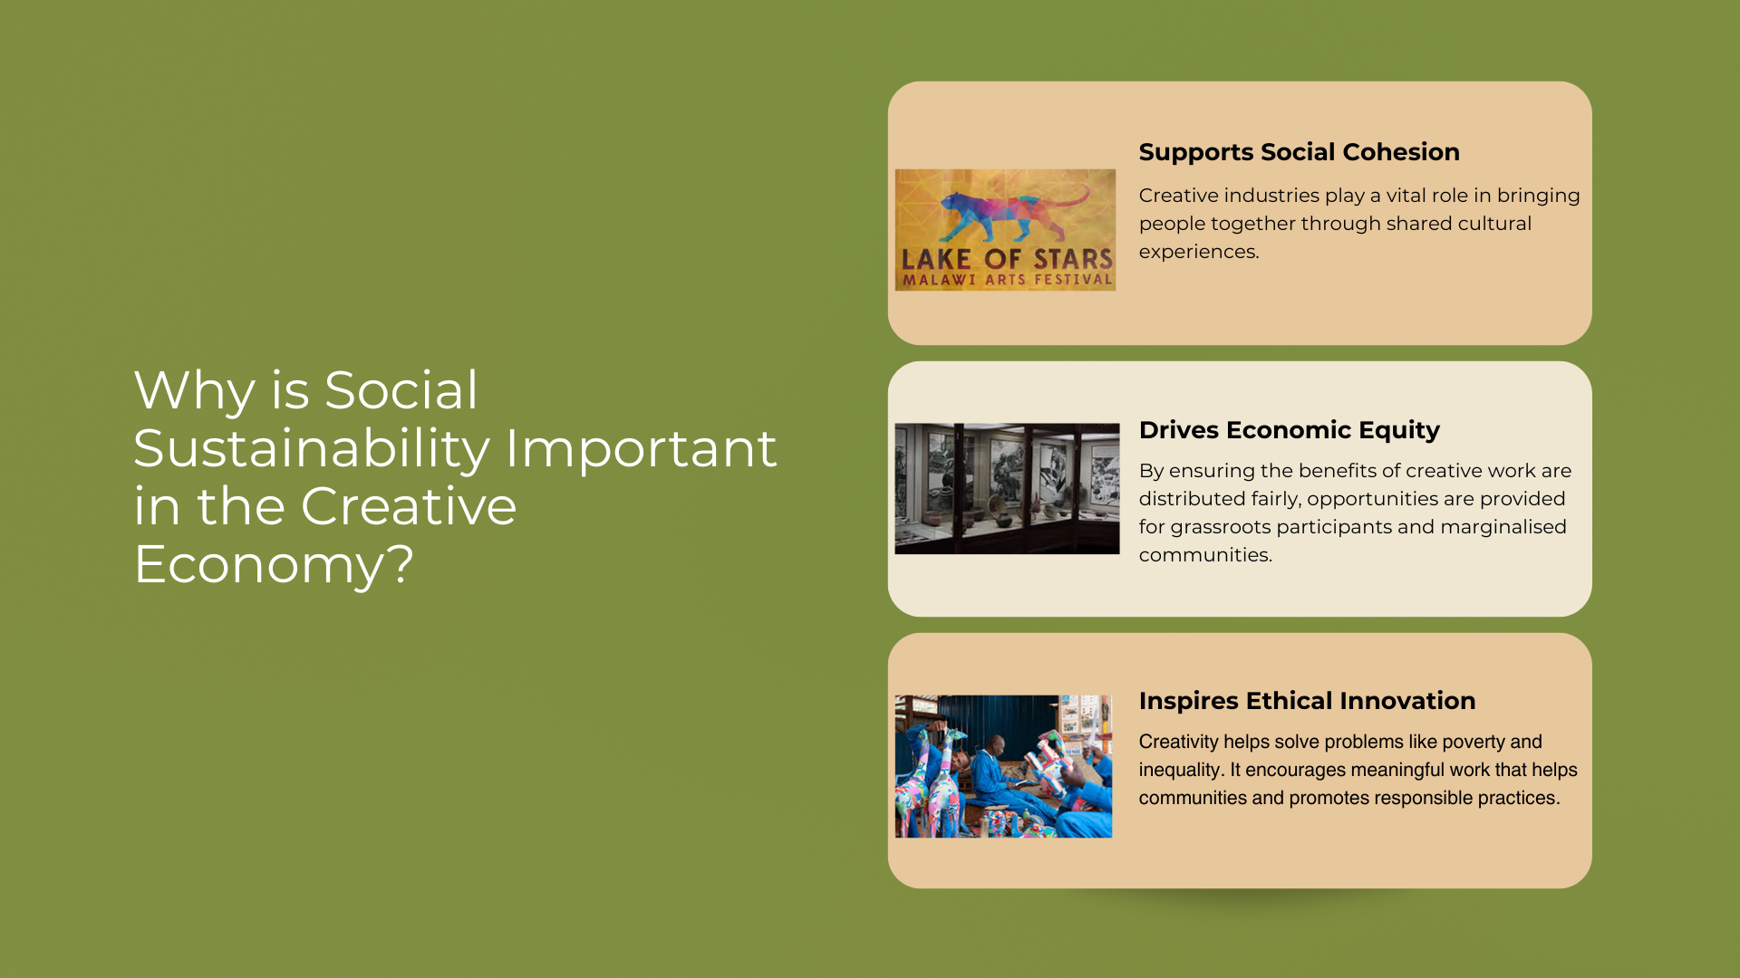
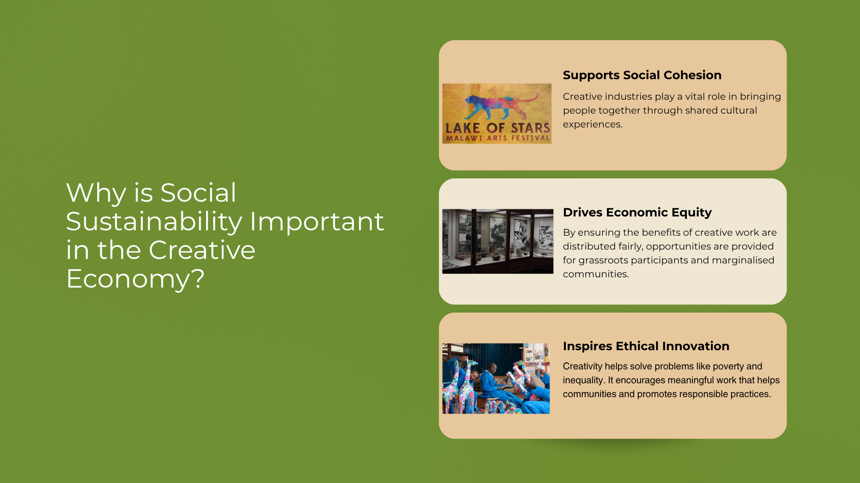

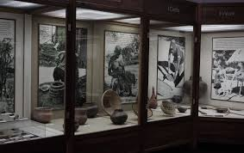
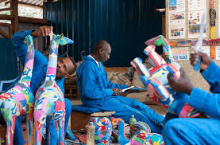
Why is Social Sustainability Important in the Creative Economy?
Fosters Social Cohesion
Creative industries play a vital role in bringing people together through shared cultural experiences.
Drives Economic Equity
Ensuring that the benefits of creative work are distributed fairly, providing opportunities to grassroots participants and marginalised communities.
Inspires Ethical Innovation
Creativity solving problems like poverty and inequality. Encouraging meaningful work to help communities and promotes responsible practices.
Example: Lake of Stars Festival
Example: Choma Museum Zambia
Example: Ocean Sole

Slide 13
Cultural Sustainability
Why is Cultural Sustainability Important?
Helps preserve and share cultural identities and values
Boosts economic and social growth by creating opportunities for local artisans, designers, and storytellers
Addresses social values by giving respect and representation to marginalised communities
Helps to preserve cultural diversity and resilience
Supports environmental goals by using traditional methods that often rely on natural, sustainable materials and community-focused production
What is Cultural Sustainability?
The use of traditional knowledge, techniques, and practices in current contexts, particularly within creative industries.
This could be done in many ways, such as using traditional arts, materials, techniques, motifs and patterns, or stories.

Slide 14
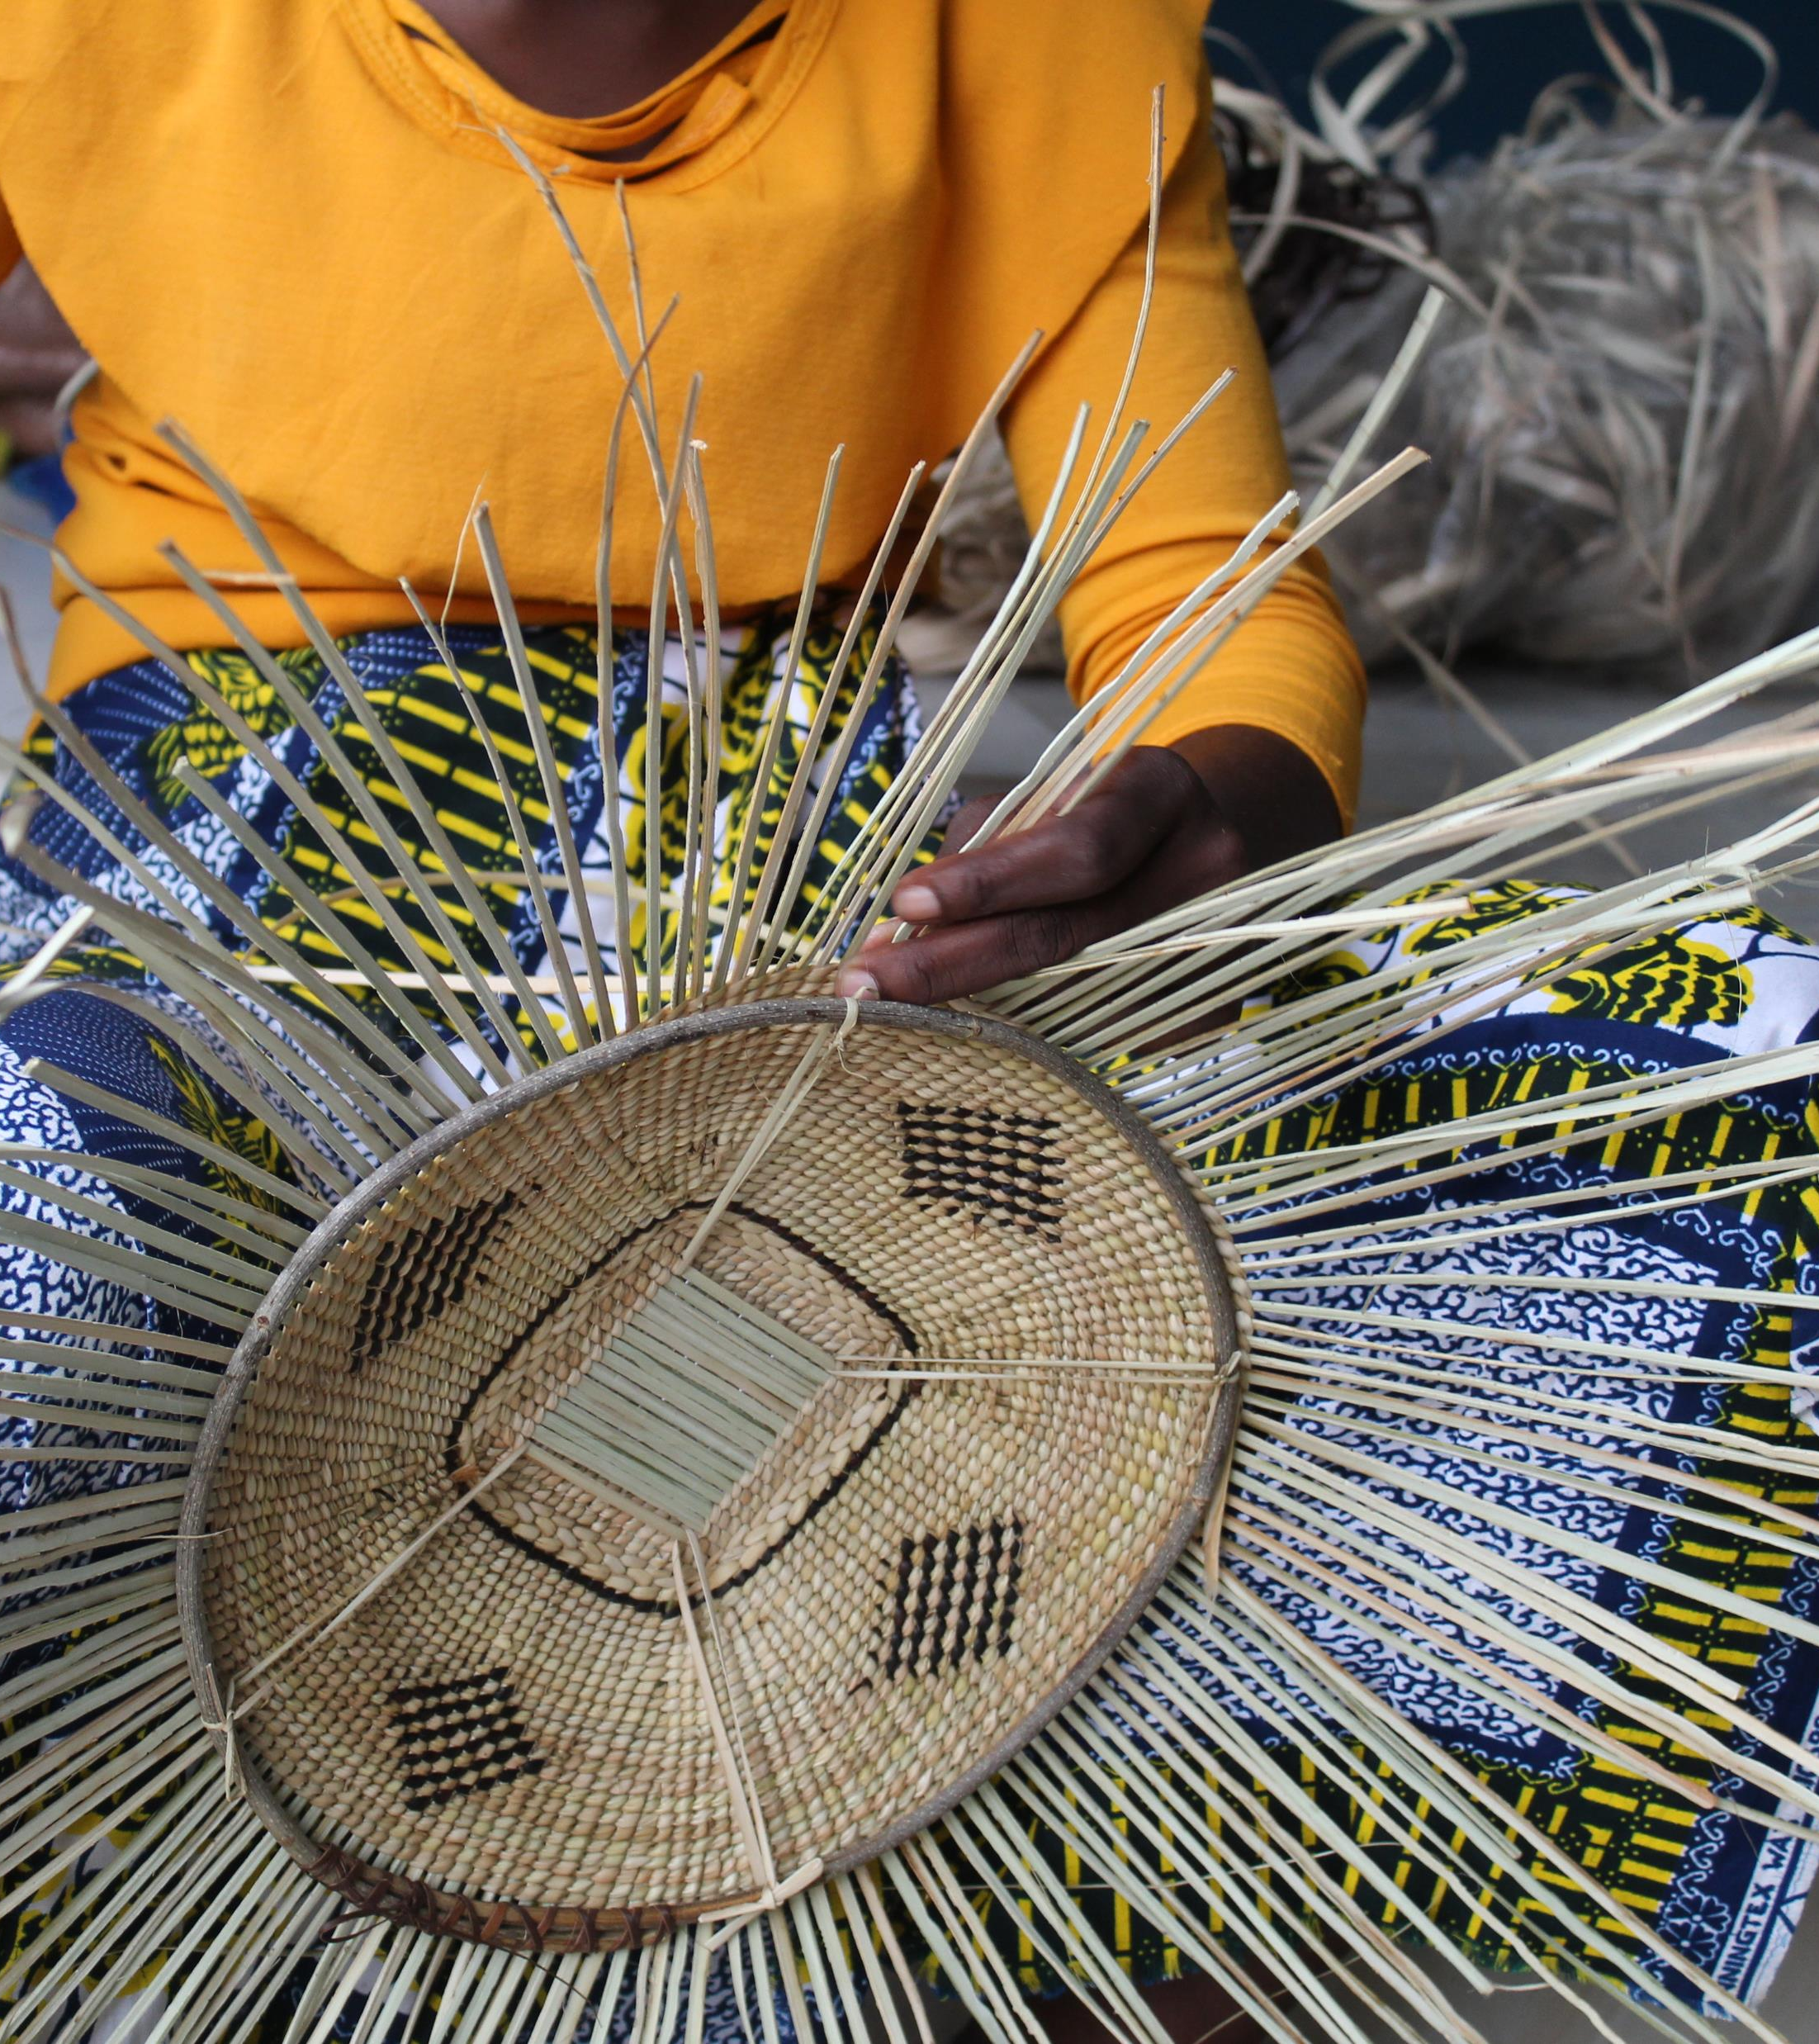
Activity 3: Keeping Cultural Heritage Alive
Watch two weavers from the Maamba Weaving Club at the Choma Museum. Their story shows how traditional weaving skills are passed down through generations from their grandmothers.
Highlights the importance of sharing knowledge between generations (preserving cultural traditions)
Shows how weaving is more than just a craft, it is a way to tell stories and express identity, reflecting the values, history, and culture of their community.
Connects to larger goal of keeping cultural traditions vibrant, supporting local economies, and promoting sustainable practices in creative industries .

Slide 15
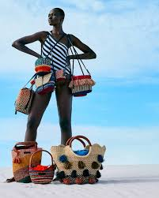
Bringing Different Types of Sustainability Together
Although each section focused on one type of sustainability, it is likely that a business that aims to be sustainable tries to be environmentally, socially and culturally sustainable.
AAKS Handcrafted Bags – Ghana – is one such example.

Slide 16
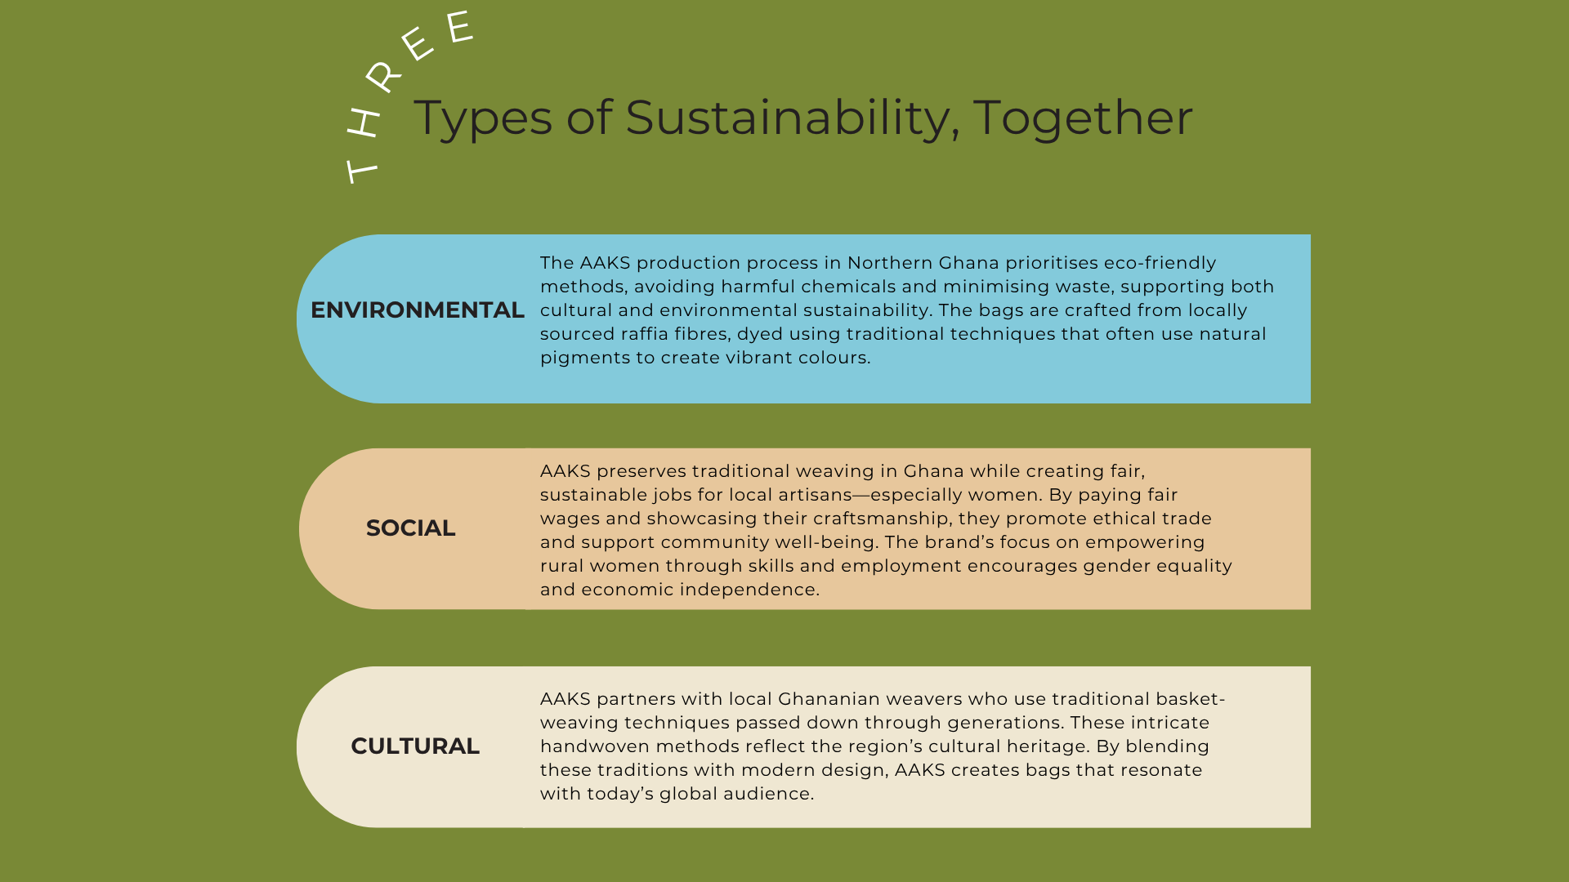
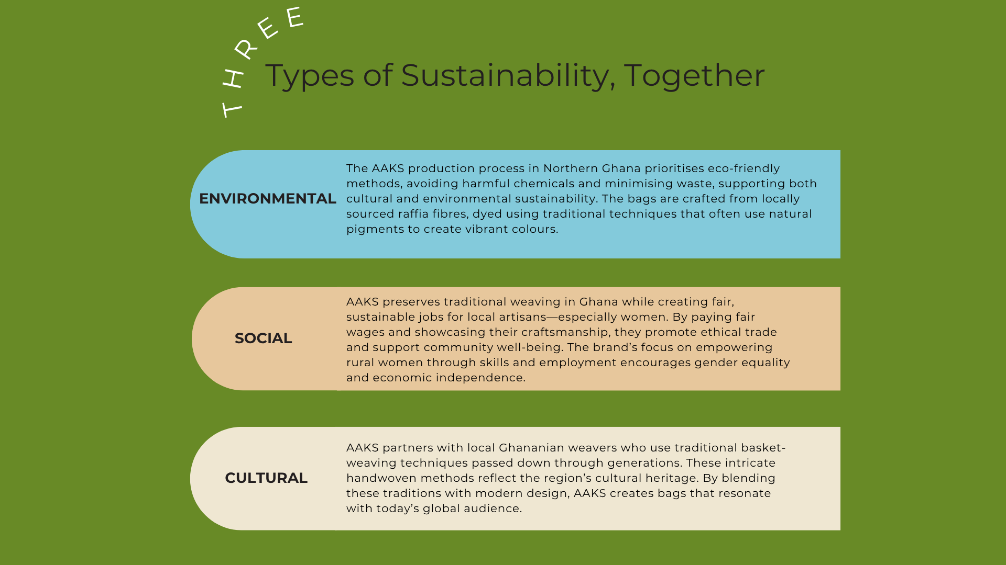
Environmental
The production process emphasises eco-friendly practices, avoiding harmful chemicals and waste. This aligns with both cultural and environmental sustainability goals.
The bags are made using raffia fibers derived from palm trees, which are locally sourced and dyed using traditional methods, often incorporating natural pigments to achieve vibrant colors.
Social
AAKS helps preserve traditional weaving techniques of northern Ghana, creating job opportunities for local artisans, particularly women. This empowers them economically and socially, while preserving the community's cultural heritage.
By paying artisans fairly for their work and offering them a platform to showcase their skills, AAKS promotes ethical business practices and fair trade. This supports the well-being of individuals and communities involved in the production process.
The brand’s focus on empowering women in rural areas of Ghana through skills development and employment is a critical aspect of social sustainability, encouraging gender equality and increasing women's economic independence.
Cultural
AAKS employs local weavers from communities in northern Ghana who use indigenous basket-weaving skills passed down through generations. The process involves intricate hand-weaving, a technique rooted in the cultural heritage of the region. While preserving the traditional weaving process, AAKS integrates modern aesthetics, ensuring the bags appeal to today’s global audience.

Slide 17
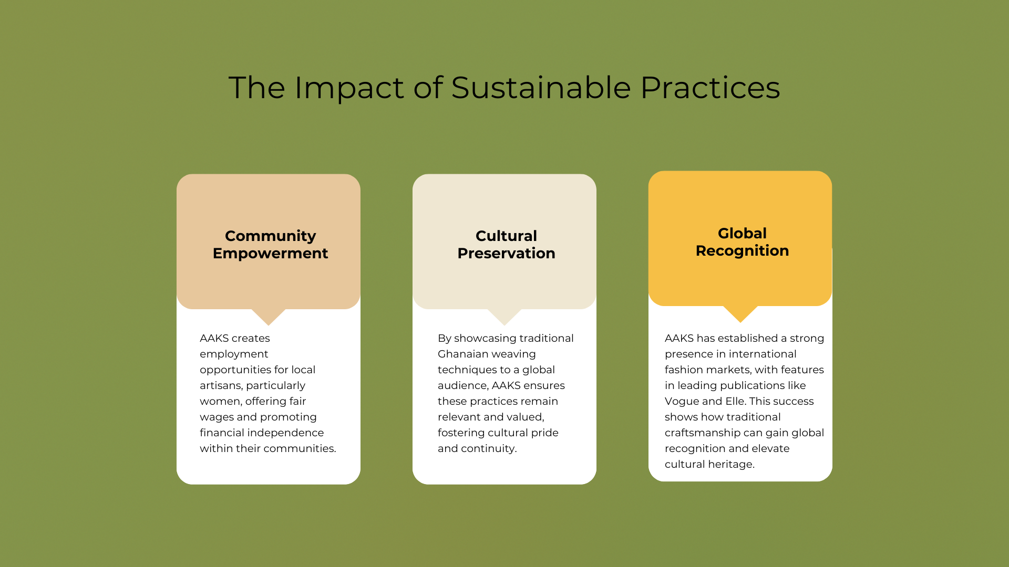
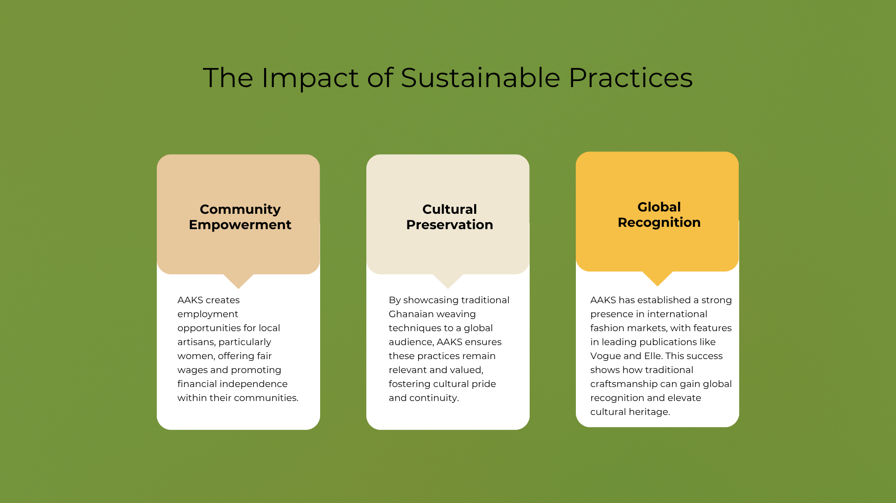
Impact of Sustainable Practices
Community Empowerment
AAKS creates employment opportunities for local artisans, particularly women, offering fair wages and promoting financial independence within their communities.
Cultural Preservation
By showcasing traditional Ghanaian weaving techniques to a global audience, AAKS ensures these practices remain relevant and valued, fostering cultural pride and continuity.
Global Recognition
The brand has successfully positioned itself in international fashion markets, featuring in high-profile outlets and publications such as Vogue and Elle. This demonstrates how integrating traditional practices can elevate cultural heritage onto a global stage.

Slide 18
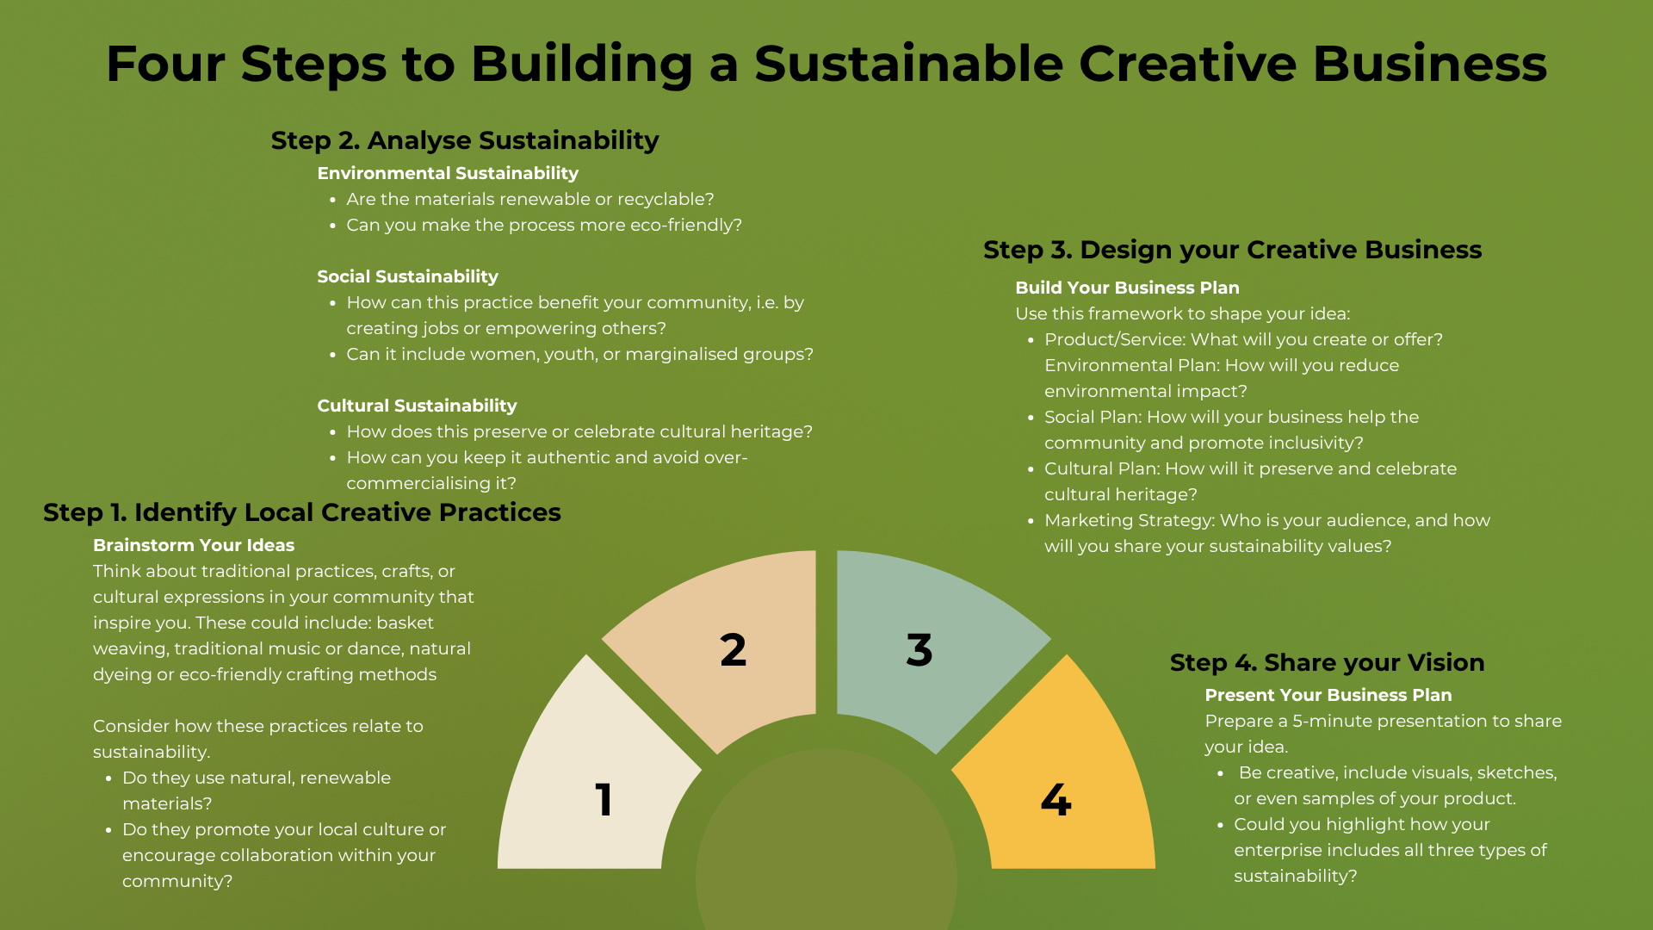
Activity 4: Sustainable Sustainability

Slide 19
In Conclusion:
What We Have Explored
The key aspects of sustainability: environmental, social, and cultural.
Practical strategies for integrating sustainability into your creative work.
Examples of businesses that have successfully incorporated sustainable practices.

