Slide 1
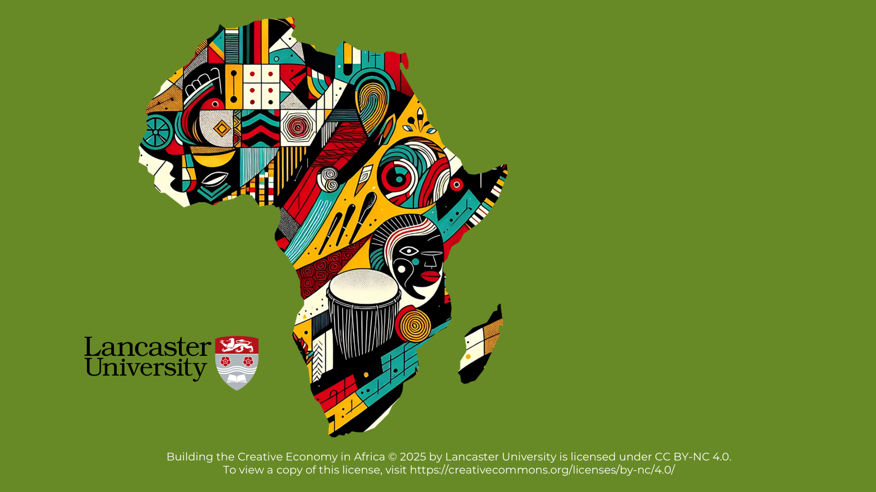

BUILDING THE CREATIVE ECONOMY IN AFRICA

Slide 2

Unit 6
Navigating Challenges: Building Resilience in the Creative Economy

Slide 3
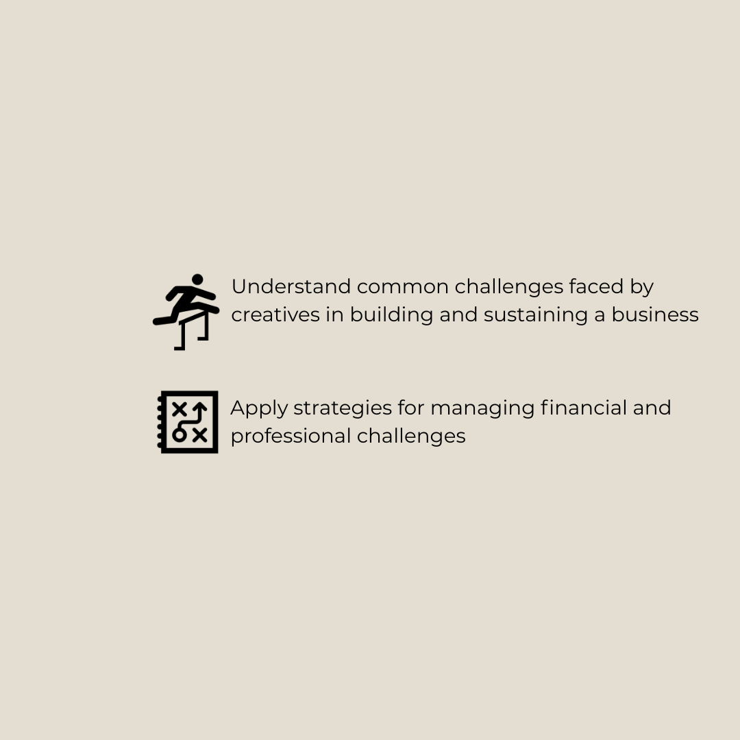
Learning Objectives

Slide 4
Ice Breaker Activity

Slide 5
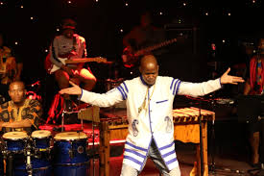
Activity 1: Challenges for Creative Professionals
The creative industry is full of opportunities but comes with challenges that need to be managed!
As you watch Volley, note down the key challenges he raises about his work.

Slide 6
Key Challenges
Competing with Big Companies
Large companies have more money and resources, making it harder for independent creators to stand out.
Competing with these giants can feel overwhelming when you are just starting out.
Misunderstanding Contracts
Not understanding contracts can lead to legal or financial problems.
Contracts can be tricky, especially if you don’t have legal knowledge, which can put you at risk.
Being Exploited
Some people might try to take advantage of your talent and passion for their own benefit.
It is important to stay alert and protect yourself from unfair treatment or deception.
Notes:
Lifted these images from the subsequent activity. Thought you can refer back to explain these so you have images to explain some of the other classifications

Slide 7

Activity 2:
Identifying Additional Challenges
The creative industry is always evolving. With new technologies, shifting trends, and societal changes, creative professionals often encounter unexpected challenges.
Let’s think about this for a moment:
1. What other challenges have you faced or do you think you might face in your creative work?

Slide 8

Activity 3:
Aysha’s Challenges
Remember Aysha from earlier in the course? She’s a creative entrepreneur and cook from Kenya who has built her business around her culinary art.
As you watch the video think about
1. What stood out to you about her challenges?

Slide 9
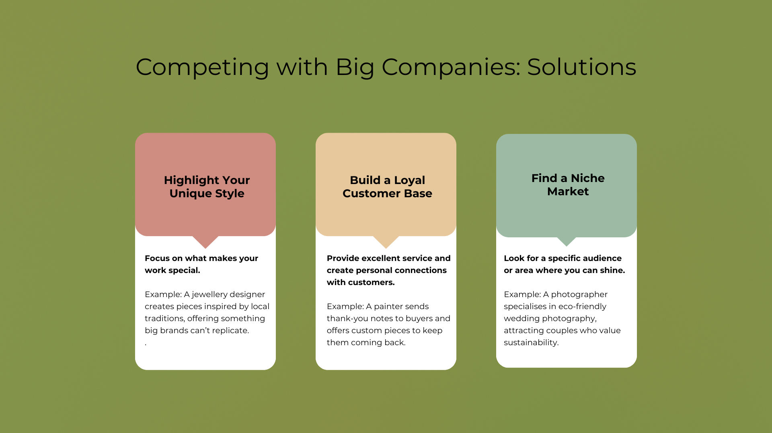
Suggested Solutions: 1
Competing with Big Companies
Highlight Your Unique Style:
Focus on what makes your work special.
Example: A jewelry designer creates pieces inspired by local traditions, offering something big brands can’t replicate.
Build a Loyal Customer Base:
Provide excellent service and create personal connections with customers.
Example: A painter sends thank-you notes to buyers and offers custom pieces to keep them coming back.
Find a Niche Market:
Look for a specific audience or area where you can shine.
Example: A photographer specializes in eco-friendly wedding photography, attracting couples who value sustainability.

Slide 10
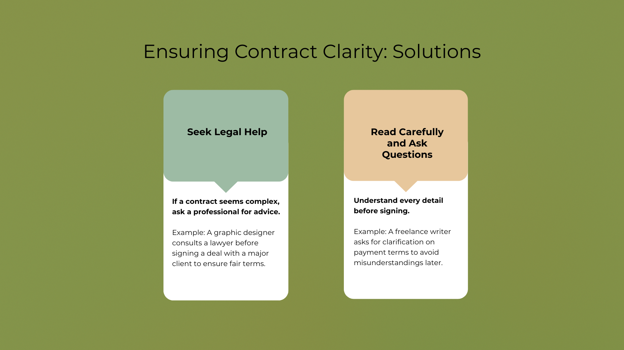

Suggested Solutions: 2
Ensuring Contract Clarity
Seek Legal Help:
If a contract seems complex, ask a professional for advice.
Example: A graphic designer consults a lawyer before signing a deal with a major client to ensure fair terms.
Read Carefully and Ask Questions:
Understand every detail before signing.
Example: A freelance writer asks for clarification on payment terms to avoid misunderstandings later.

Slide 11
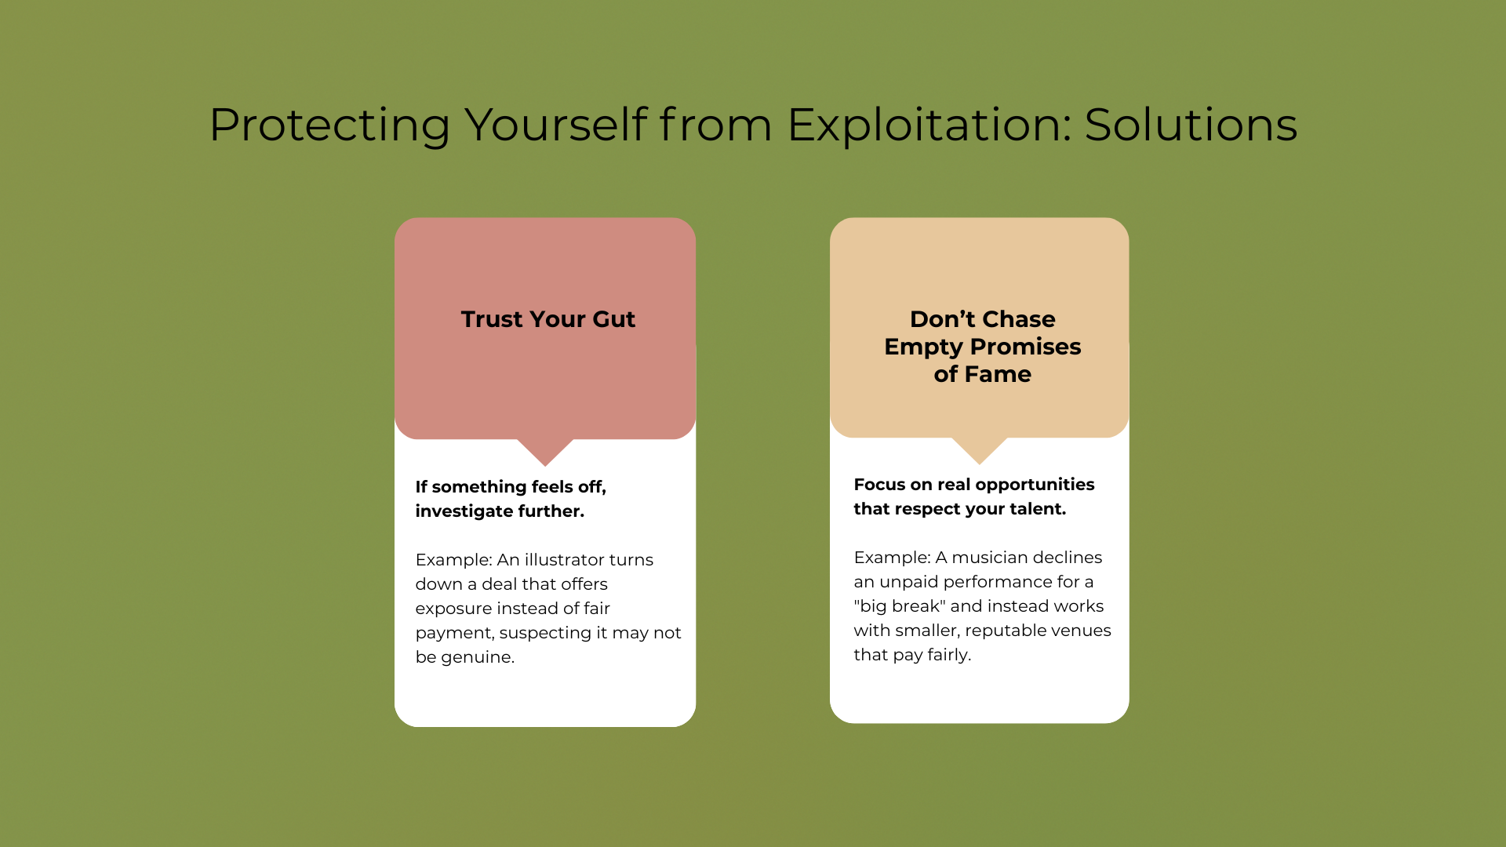

Suggested Solutions: 3
Protect Yourself from Exploitation
Trust Your Gut:
If something feels off, investigate further.
Example: An illustrator turns down a deal that offers exposure instead of fair payment, suspecting it may not be genuine.
Don’t Chase Empty Promises of Fame:
Focus on real opportunities that respect your talent.
Example: A musician declines an unpaid performance for a "big break" and instead works with smaller, reputable venues that pay fairly.

Slide 12
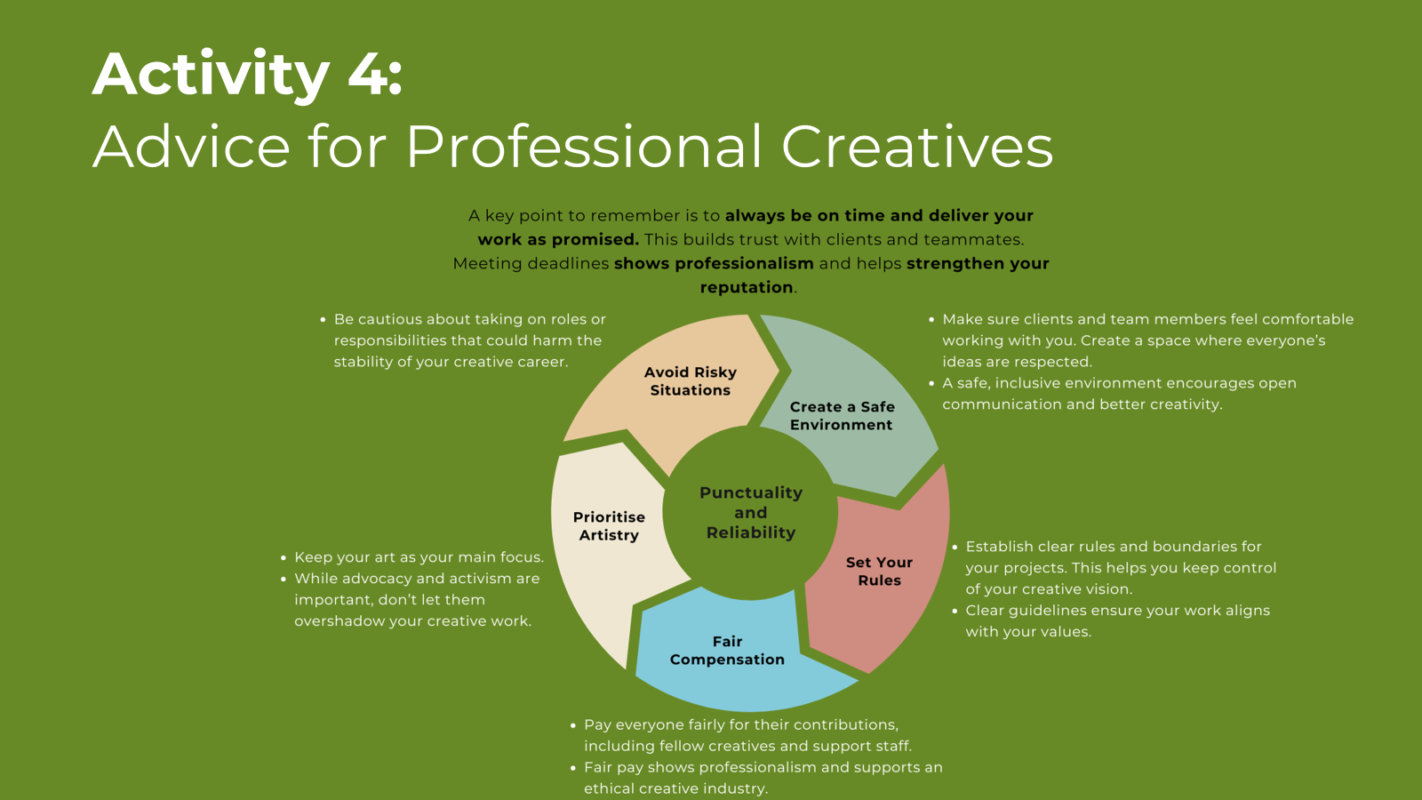
Activity 4:
Advice for Creative Professionals

Slide 13
In Conclusion: What We Have Explored
The common challenges faced by creatives, including financial, emotional, and professional hurdles.
Practical strategies for overcoming these challenges and maintaining balance.
Ways to build resilience and ensure sustainable growth in the creative economy.

Slide 14
Course Conclusion
Congratulations! You have completed the course!
During these six units, you have developed a toolkit to start turning your artistic talents into a thriving business by:
Understanding the creative economy and its benefits for individuals and communities
Crafting a business vision that aligns with market needs
Building your audience and market presence with strategic marketing tools
Fostering collaboration to enhance creativity, efficiency, and community impact
Creating your products with the three types of sustainability in mind
Applying professional standards when facing challenges

Slide 15
Before you go…
At the start of this course, we asked you to think about the following three statements and rate them between 1 and 5.
I understand what the Creative Economy is
I know how to generate an income from a niche market
I know how to use my African culture and heritage within a creative business
Now go back to the evaluation form and mark your Post-Course Self-Assessment.
Do you feel more confident about how to turn your creative passion, rooted in African culture and heritage, into a meaningful business that thrives in niche markets and contributes to the broader creative economy?
Also, please take a minute or two to share your thoughts, suggestions and ideas about this course on the evaluation form. We’d love to hear your feedback!

